Slide 1
Partner Logo FPO
Power what's possible
Evaluating the business case of Surface with Microsoft 365
Pitch Deck for Channel

Slide 2
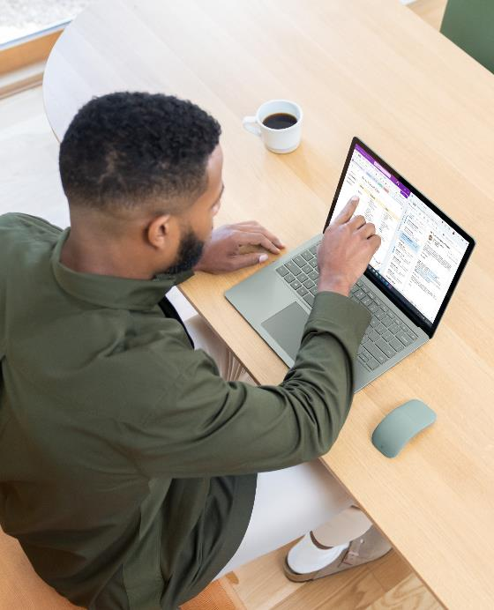
Drive new value with laptops designed by Microsoft
When leaders equip their employees with Surface, they’re creating new possibilities—one device at a time.
Power what's possible
Evaluating the business case of Surface with Microsoft 365

Slide 3
Your device decisions drive value
Between direct savings, IT efficiency, and employee experience, Surface with Microsoft 365 doesn’t just provide savings compared with other devices. It creates new value by enabling up to $9,036 in additional benefits over three years.¹
Read the study at www.aka.ms/SurfaceIDCWhitepaper
Outfitting your employees with the right tools for the job has never been more critical. IT teams are looking for ways to increase security, manage devices in the evolving hybrid workplace, and deliver powerful experiences that increase productivity for employees.
To justify the hardware and software expense that comes along with those benefits, recent research from IDC demonstrates that when leaders choose Surface and Microsoft 365, the return on investment is greater than the sum of their cost.
¹A Business Value White Paper, commissioned by Microsoft September 2022 | Doc. #US49453722
IDC Research Study conducted from surveys and interviews between December 2021 – February 2022. All respondents were IT decision-makers at large organizations (250-5000+ employees) representing organizations from the United States, Australia, India, Spain, France, United Kingdom, New Zealand, and Germany. Cost & Savings findings based on average cost and time estimates provided directly by respondents; actual costs and savings may vary based on your specific Device Mix and deployment
For the detailed study, click here.

Slide 4
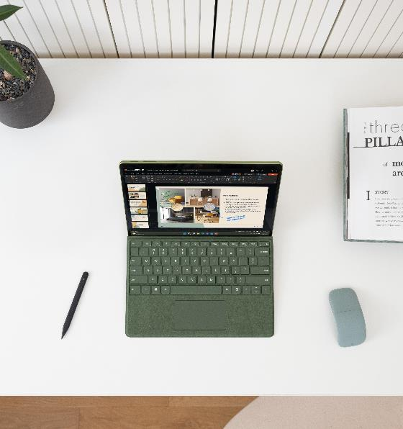
Surface devices unlock new possibilities for employees to get everyday work done faster so they can focus on the bigger picture. They also empower IT to find new time and cost savings to advance digital innovation.
Employee Experience
Productive devices make employees feel valued and engaged so they can achieve their best.
Direct Savings
Consolidate hardware with versatile devices, reduce spending on peripherals, and decrease operational costs.
IT Efficiency
Devices optimized for Microsoft experiences require less IT staff time to deploy, manage, support, and secure.
Read the study at www.aka.ms/SurfaceIDCWhitepaper

Slide 5
Evaluating the business case of Surface with Microsoft 365
What research methods did IDC use?
Long-form interviews with senior decision makers
Short-form surveys with decision makers from IT, line of business, and procurement
Comparing the costs and benefits of Surface vs. non-Surface devices
Two measures
Savings: Direct financial outcomes
Benefits: Qualitative or indirect impacts
Read the study at www.aka.ms/SurfaceIDCWhitepaper
What were we trying to learn?
In 2021, Microsoft commissioned an IDC study to understand the total cost of ownership of
Microsoft Surface devices for enterprises.¹ The research centered on one key metric: ROI over 3 years of device ownership.¹
What was the scope?
17 in-depth enterprise customer reviews
700 short-form survey responses from Surface customers and 100 from non-customers
Businesses across 20 industries and 2 public-sector organizations
¹A Business Value White Paper, commissioned by Microsoft September 2022 | Doc. #US49453722
IDC Research Study conducted from surveys and interviews between December 2021 – February 2022. All respondents were IT decision-makers at large organizations (250-5000+ employees) representing organizations from the United States, Australia, India, Spain, France, United Kingdom, New Zealand, and Germany. Cost & Savings findings based on average cost and time estimates provided directly by respondents; actual costs and savings may vary based on your specific Device Mix and deployment
For the detailed study, click here.

Slide 6
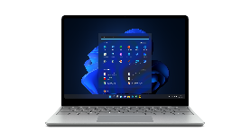
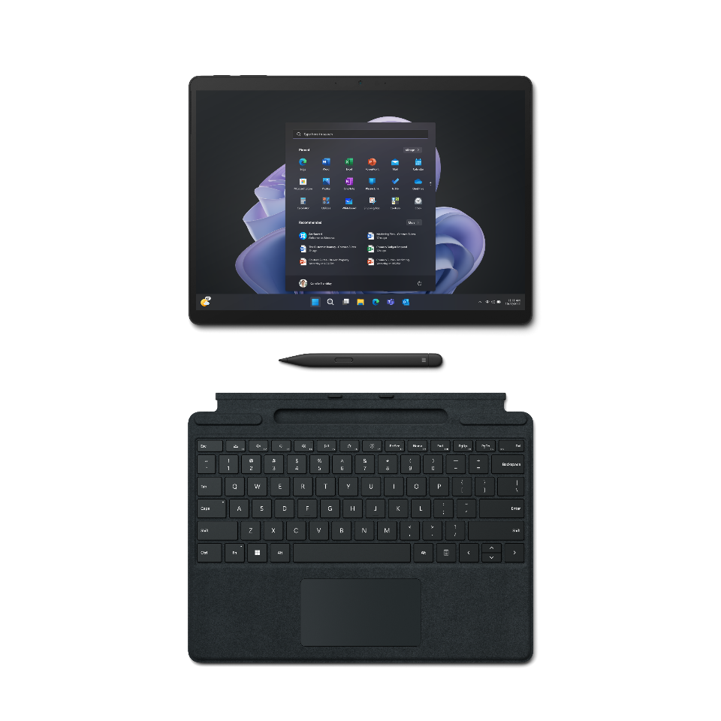
The Surface value grid
When decision makers choose Surface, they’re extending what’s possible for their people and their business
IDC’s research uncovered savings and benefits across three areas:¹
Increased productivity
Enhanced creativity
Read the study at www.aka.ms/SurfaceIDCWhitepaper
Smooth collaboration
Employee Experience
Uptime reliability
Reduced third-party support
Easy device management
Fewer incidents and quicker resolution
Higher residual value
Direct Savings
IT Efficiency
Lower security costs
¹A Business Value White Paper, commissioned by Microsoft September 2022 | Doc. #US49453722
IDC Research Study conducted from surveys and interviews between December 2021 – February 2022. All respondents were IT decision-makers at large organizations (250-5000+ employees) representing organizations from the United States, Australia, India, Spain, France, United Kingdom, New Zealand, and Germany. Cost & Savings findings based on average cost and time estimates provided directly by respondents; actual costs and savings may vary based on your specific Device Mix and deployment.
For the detailed study, click here.
Accessory savings
Fewer helpdesk calls

Slide 7
Surface unlocks savings
But direct savings are just the beginning
Read the study at www.aka.ms/SurfaceIDCWhitepaper
It starts with savings on devices. Over a three-year period, Surface simplifies your hardware lineup and reduces IT costs.¹
Costs per device over three years | Savings per device
$1,355: Average Surface laptop or 2-in-1* | $115 increased residual value, 31% higher than other PC* devices
$1,296: Microsoft 365 E3 subscription | $58 reduction in IT costs from 23% lower third-party support and security expenses
$344: Accessories | $120 in accessory savings, a 26% reduction in peripherals
$243: Extended warranty and maintenance
$3,238: Total three-year cost per Surface | $293: Device savings per Surface over 3 years
¹A Business Value White Paper, commissioned by Microsoft September 2022 | Doc. #US49453722
IDC Research Study conducted from surveys and interviews between December 2021 – February 2022. All respondents were IT decision-makers at large organizations (250-5000+ employees) representing organizations from the United States, Australia, India, Spain, France, United Kingdom, New Zealand, and Germany. Cost & Savings findings based on average cost and time estimates provided directly by respondents; actual costs and savings may vary based on your specific Device Mix and deployment.
For the detailed study, click here.
*Data point derived from 17 in-depth interviews. All other data points derived from 800 survey results (700 Surface organizations with at least 150 Surface Laptop and 2-in-1 Tablets available since 2019, 100 non-Surface organizations). Surface Residual Value adjusted by IDC to reflect average after 36 months.

Slide 8
$293
$5,635
$3,108
Direct
Savings
IT
Efficiency
Employee
Experience
Additional benefits add up
Businesses who choose Surface devices aren’t just seeing savings on device costs. They’re unlocking new value that amplifies their employees’ impact and streamlines operations.
$5,635
in IT administration savings¹
49%
fewer helpdesk incidents¹
Equipping your team with Surface devices provides up to $8,743 in additional IT and productivity benefits over 3 years.¹
$3,108
gains in employee productivity and retention¹
Read the study at www.aka.ms/SurfaceIDCWhitepaper
74 hrs
¹A Business Value White Paper, commissioned by Microsoft September 2022 | Doc. #US49453722
IDC Research Study conducted from surveys and interviews between December 2021 – February 2022. All respondents were IT decision-makers at large organizations (250-5000+ employees) representing organizations from the United States, Australia, India, Spain, France, United Kingdom, New Zealand, and Germany. Cost & Savings findings based on average cost and time estimates provided directly by respondents; actual costs and savings may vary based on your specific Device Mix and deployment
For the detailed study, click here.
more productivity per employee¹
Between direct savings and additional benefits, your organization can save up to $9,036 per Surface device over 3 years.¹
With an average three-year device cost of $3,238, Surface + Microsoft 365 provides a total ROI worth up to 2.8x your initial investment.¹
Read the study at www.aka.ms/SurfaceIDCWhitepaper

Slide 9
$293
$5,635
$3,108
Direct
Savings
IT
Efficiency
Employee
Experience
Between direct savings and additional benefits, your organization can save up to $9,036 per Surface device over 3 years.¹
With an average three-year device cost of $3,238, Surface + Microsoft 365 provides a total ROI worth up to 2.8x your initial investment.¹
Read the study at www.aka.ms/SurfaceIDCWhitepaper
¹A Business Value White Paper, commissioned by Microsoft September 2022 | Doc. #US49453722
IDC Research Study conducted from surveys and interviews between December 2021 – February 2022. All respondents were IT decision-makers at large organizations (250-5000+ employees) representing organizations from the United States, Australia, India, Spain, France, United Kingdom, New Zealand, and Germany. Cost & Savings findings based on average cost and time estimates provided directly by respondents; actual costs and savings may vary based on your specific Device Mix and deployment.
For the detailed study, click here.

Slide 10
Breaking down the benefits¹
Read the study at www.aka.ms/SurfaceIDCWhitepaper
 | Procurement | Deployment | Daily Operations | Support & Maintenance | End-of-life | Total Benefits (per device)
Hard Cost Savings (per device) | 26% $120 saved on accessories 44% $3,756 saved due to fewer devices 23% $58 saved on 3rd party support |  |  | 6% $2 more IT staff time for Surface Training | 31% $115 higher residual value* | $4,047
Soft Cost Savings (per device) |  | 21% $42 saved in easy deployment | 40% $810 saved from lower ongoing maintenance 4% $105 higher employee retention | 49% $885 saved due to fewer helpdesk incidents 34% $126 saved from fewer security incidents |  | $1,968
Productivity Gains (per device) |  | 27% $60 saved through reduced employee waiting time for deployment | +74 hours $2,773 increase in employee productivity 32% $81 gains from faster boot time, with 21% fewer reboots | 30% $89 savings from reduced employee time for security incident resolution 3% $18 less staff time for ongoing security |  | $3,021
Total Benefits (per device) | $3,934 | $102 | $3,769 | $1,116 | $115 | ~$9,036
¹A Business Value White Paper, commissioned by Microsoft September 2022 | Doc. #US49453722
IDC Research Study conducted from surveys and interviews between December 2021 – February 2022. All respondents were IT decision-makers at large organizations (250-5000+ employees) representing organizations from the United States, Australia, India, Spain, France, United Kingdom, New Zealand, and Germany. Cost & Savings findings based on average cost and time estimates provided directly by respondents; actual costs and savings may vary based on your specific Device Mix and deployment.
For the detailed study, click here.
*Data point derived from 17 in-depth interviews. All other data points derived from 800 survey results (700 Surface organizations with at least 150 Surface Laptop and 2-in-1 Tablets available since 2019, 100 non-Surface organizations). Surface Residual Value adjusted by IDC to reflect average after 36 months.

Slide 11
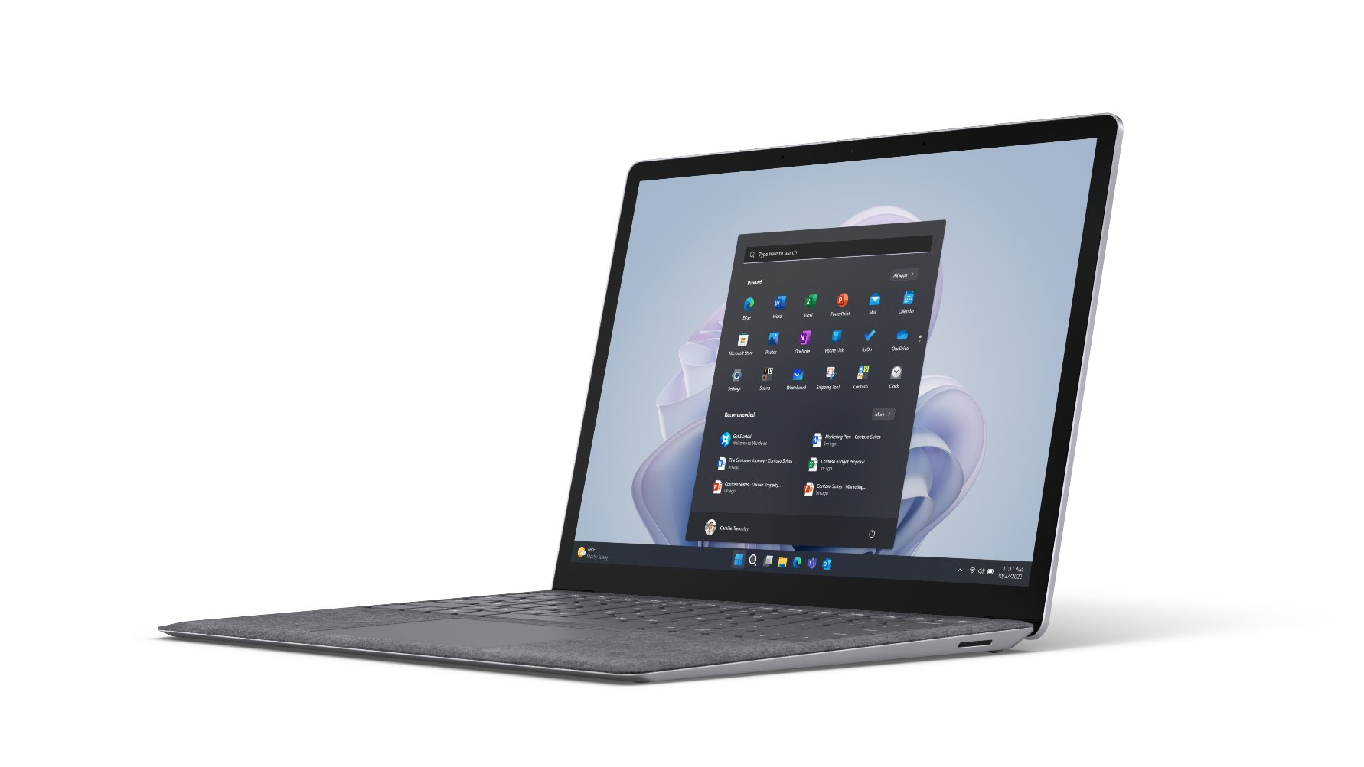
Power what’s possible
Surface devices are greater than the sum of
their cost.
It’s much more than just speeds and feeds. Laptops designed by Microsoft empower employees to feel and do their best work—from anywhere. At the same time, they simplify device management and IT support.
Over three years, your business could create new value that more than doubles your investment per device.
What’s next?
Read the executive summary of IDC’s study at www.aka.ms/SurfaceIDCExecsummary to get the full picture.
Connect with your Surface sales team to get more information on what Surface can do for you.
Work with us to evaluate Surface’s total cost of ownership and understand the ROI for your business.
Empower employees to redefine what’s possible with devices that simplify your IT spend.

Slide 12
Appendix
Evaluating the business case of Surface with Microsoft 365

Slide 13
Employee Experience
Additional benefits
Direct Savings
Direct cost savings
IT Efficiency
Additional benefits and cost savings

Slide 14
Engaged employees power what’s possible
Read the study at www.aka.ms/SurfaceIDCWhitepaper
Surface has the highest product satisfaction of any Windows 10 or 11 device
5.5 HRS
gained from reduced helpdesk calls3
Uptime reliability
Optimal display real estate with 3:2 aspect ratio, high-resolution PixelSense™ displays.
Whiteboard and edit effortlessly with the low latency Surface pen¹, featuring 4,096 pressure.
Lightweight with all-day battery life to enhance mobility and increase round-the-clock productivity.²
11.6 HRS
saved from increased mobility3
Increased productivity
Be heard with enhanced dual far-field mics and crystal-clear speakers with immersive Dolby™ Audio™ Premium sound for virtual meetings.
Be present with front and rear facing HD cameras that show your best on Microsoft Teams video calls.¹
7.7 HRS
recovered from saved meeting time3
Meeting time saved
¹Software license required for some features. Sold separately.
²Battery life varies significantly with settings, usage and other factors.
³A Business Value White Paper, commissioned by Microsoft September 2022 | Doc. #US49453722
IDC Research Study conducted from surveys and interviews between December 2021 – February 2022. All respondents were IT decision-makers at large organizations (250-5000+ employees) representing organizations from the United States, Australia, India, Spain, France, United Kingdom, New Zealand, and Germany. Cost & Savings findings based on average cost and time estimates provided directly by respondents; actual costs and savings may vary based on your specific Device Mix and deployment.
For the detailed study, click here.

Slide 15
Employee experience differentiators | performance
Read the study at www.aka.ms/SurfaceIDCWhitepaper
Microsoft 365 Enterprise collaboration tools,¹ including Teams, Skype, One-touch meetings, and cloud storage technologies enable higher productivity in a remote or hybrid working environment.
11.6 HRS
saved yearly per user through increased mobility and capability2
Touchscreen, pen and keyboard¹
Run applications concurrently with powerful processors from Intel, ARM, and AMD.
Enhanced performance with Intel® 10th Gen. 10NM quad-core chipsets.
5.5 HRS
gained yearly per user due to reduced time lost to helpdesk issues2
Parallel application processing
¹Software license required for some features. Sold separately.
²A Business Value White Paper, commissioned by Microsoft September 2022 | Doc. #US49453722
IDC Research Study conducted from surveys and interviews between December 2021 – February 2022. All respondents were IT decision-makers at large organizations (250-5000+ employees) representing organizations from the United States, Australia, India, Spain, France, United Kingdom, New Zealand, and Germany. Cost & Savings findings based on average cost and time estimates provided directly by respondents; actual costs and savings may vary based on your specific Device Mix and deployment.
For the detailed study, click here.

Slide 16
Employee Experience
Additional benefits
Direct Savings
Direct cost savings
IT Efficiency
Additional benefits and cost savings

Slide 17
Enabling direct savings
Read the study at www.aka.ms/SurfaceIDCWhitepaper
Uniquely versatile devices help you simplify and streamline your hardware environment
31%
higher residual value at the device’s end of life*
Higher residual value
A higher residual value than comparable Windows devices by up to $115 at their end of life.¹
Reduce the costs of 3rd party support for deployment, annual management services, and security solutions by ~23% with Surface devices.¹
Minimize purchasing peripheral devices for virtual meetings with a 79% reduction in the need for cameras, 65% in lights, and 50% in headsets.
23%
fewer helpdesk incidents3
Fewer 3rd party solutions
$120
reduction in peripheral accessory costs1
Fewer peripheral devices
¹A Business Value White Paper, commissioned by Microsoft September 2022 | Doc. #US49453722
IDC Research Study conducted from surveys and interviews between December 2021 – February 2022. All respondents were IT decision-makers at large organizations (250-5000+ employees) representing organizations from the United States, Australia, India, Spain, France, United Kingdom, New Zealand, and Germany. Cost & Savings findings based on average cost and time estimates provided directly by respondents; actual costs and savings may vary based on your specific Device Mix and deployment.
For the detailed study, click here.
*Data point derived from 17 in-depth interviews. All other data points derived from 800 survey results (700 Surface organizations with at least 150 Surface Laptop and 2-in-1 Tablets available since 2019, 100 non-Surface organizations). Surface Residual Value adjusted by IDC to reflect average after 36 months.

Slide 18
Employee Experience
Additional benefits
Direct Savings
Direct cost savings
IT Efficiency
Additional benefits and cost savings

Slide 19
IT efficiency | Supporting engaged employees
Read the study at www.aka.ms/SurfaceIDCWhitepaper
Discover ways for IT to find new time and cost savings and amplify innovation.
21%
reduced IT staff for deployment3
Zero touch deployment
Rapidly deploy Surface devices straight to users with a seamless, factory-enabled Autopilot implementation.
Remotely manage thousands of Surface devices down to the firmware layer with Surface’s Device Firmware Configuration Interface and Endpoint Manager.²
Agility with Security: Surface uses Microsoft’s UEFI² to reduce firmware layer threats and Windows Update for Business to stay secure.
49%
fewer helpdesk incidents3
Fewer incidents / quicker resolution
Maintain flexibility in a crisis with decentralized provisioning and deployment so new employees can begin work, enroll their personal devices, and access files and applications from home.¹
¹Software license required for some features. Sold separately.
²Surface Go and Surface Go 2 use a third-party UEFI and do not support DFCI. DFCI is currently available for Surface Book 3, Surface Laptop 3, Surface Pro 7, and Surface Pro X. Find out more about managing Surface UEFI settings at https://docs.microsoft.com/en-us/surface/manage-surface-uefi-settings.
³A Business Value White Paper, commissioned by Microsoft September 2022 | Doc. #US49453722
IDC Research Study conducted from surveys and interviews between December 2021 – February 2022. All respondents were IT decision-makers at large organizations (250-5000+ employees) representing organizations from the United States, Australia, India, Spain, France, United Kingdom, New Zealand, and Germany. Cost & Savings findings based on average cost and time estimates provided directly by respondents; actual costs and savings may vary based on your specific Device Mix and deployment.
For the detailed, study click here.
34%
fewer security incidents3
Chip to cloud protection

Slide 20
IT efficiency | Simplified deployment and consolidation
Read the study at www.aka.ms/SurfaceIDCWhitepaper
Zero-touch device provisioning to rapidly deploy Surface devices straight to users with a seamless, factory enabled Autopilot implementation. Manage device IDs through Microsoft Intune¹ (End Point Manager) during setup or after the fact.
21%
Provisioning time saved per device due to Autopilot2
Autopilot deployment
44%
of organizations consolidated 2.3 devices on average per Surface2
Reduction of hardware devices
¹Software license required for some features. Sold separately.
²A Business Value White Paper, commissioned by Microsoft September 2022 | Doc. #US49453722
IDC Research Study conducted from surveys and interviews between December 2021 – February 2022. All respondents were IT decision-makers at large organizations (250-5000+ employees) representing organizations from the United States, Australia, India, Spain, France, United Kingdom, New Zealand, and Germany. Cost & Savings findings based on average cost and time estimates provided directly by respondents; actual costs and savings may vary based on your specific Device Mix and deployment.
For the detailed study, click here.

Slide 21
IT efficiency |
Security incidents
Read the study at www.aka.ms/SurfaceIDCWhitepaper
49%
fewer security interventions required from IT teams1
Fewer security incidents
Minimize security incidents through enterprise-grade security with Conditional Access, Microsoft Defender ATP, Windows Update for Business, Microsoft Intune (End Point Manager), remote wipe, Exploit Guard, and App guard.¹
Reduce the time to resolve a security incident with Endpoint Manager, Surface DFCI, geo-location, geo-monitoring, and hardware control, complemented by built-in secure HW TPM 2.0, BitLocker, DFCI and SEMM, Secure UEFI, and Windows Hello.²
34%
fewer security incidents1
Less time to respond
Cut down the cost to recover from a security incident by ~$8.5k per device on an annual basis.¹
$42
saved per Surface through reduced security incident responses over three years2
Reduced cost to recover from incidents
¹Software license required for some features. Sold separately.
²A Business Value White Paper, commissioned by Microsoft September 2022 | Doc. #US49453722
IDC Research Study conducted from surveys and interviews between December 2021 – February 2022. All respondents were IT decision-makers at large organizations (250-5000+ employees) representing organizations from the United States, Australia, India, Spain, France, United Kingdom, New Zealand, and Germany. Cost & Savings findings based on average cost and time estimates provided directly by respondents; actual costs and savings may vary based on your specific Device Mix and deployment.
For the detailed study, click here.

Slide 22
IT efficiency | Helpdesk and ongoing maintenance
Read the study at www.aka.ms/SurfaceIDCWhitepaper
49%
fewer helpdesk incidents per month1
Fewer helpdesk incidents
Reduce the time to resolve a helpdesk incident with Advanced Exchange², next-business-day replacement, and service plan options from one to four years.
Reduce the time to resolve a desk-side support incident through Smart busy check and pause or defer updates to Windows for Business without disrupting end-user activity.
46%
less time to resolve helpdesk calls per year1
Less time in helpdesk call support
35+
hours of IT staff time gained per Surface over three years1
Less time in desk-side support
¹A Business Value White Paper, commissioned by Microsoft September 2022 | Doc. #US49453722
IDC Research Study conducted from surveys and interviews between December 2021 – February 2022. All respondents were IT decision-makers at large organizations (250-5000+ employees) representing organizations from the United States, Australia, India, Spain, France, United Kingdom, New Zealand, and Germany. Cost & Savings findings based on average cost and time estimates provided directly by respondents; actual costs and savings may vary based on your specific Device Mix and deployment.
For the detailed study, click here.

Slide 23
International Data Corporation (IDC) is the premier global provider of market intelligence, advisory services, and events for the information technology, telecommunications, and consumer technology markets.
For this Microsoft-commissioned study, IT decision makers participated in surveys and interviews as part of IDC’s Business Value analysis. These decision makers spanned 817 organizations, three continents, 20 private industry verticals, and two public sector verticals.
Read the study at www.aka.ms/SurfaceIDCWhitepaper

Slide 24
Partner Logo FPO
Thank you!
If you have any questions, please feel free to reach out to our team.
[Contact email]

