Slide 1
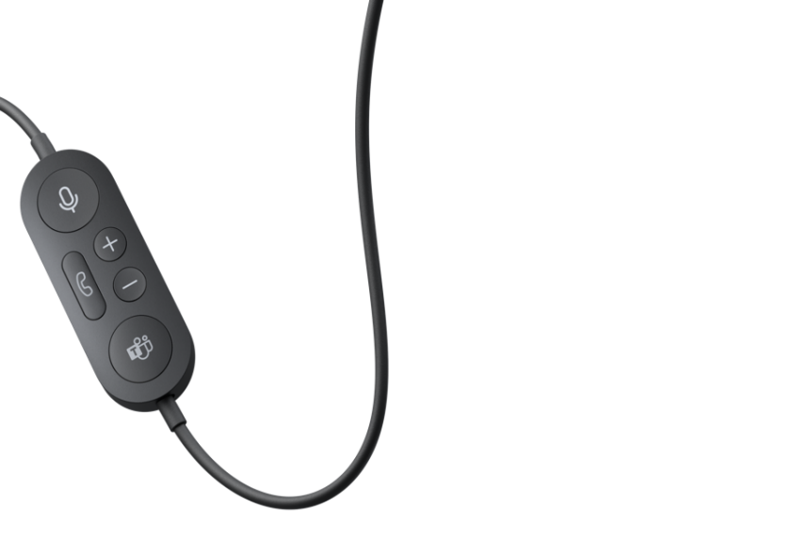
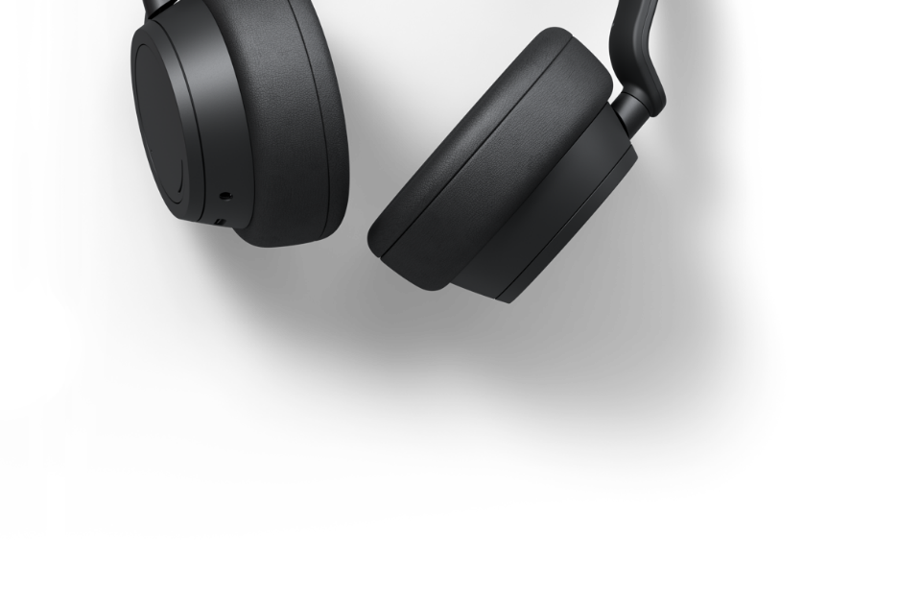
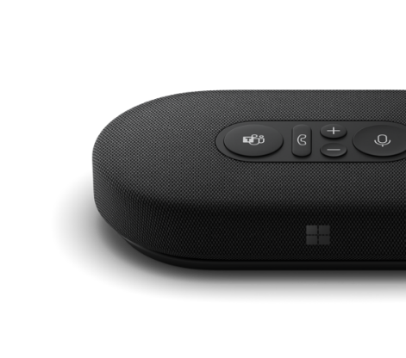
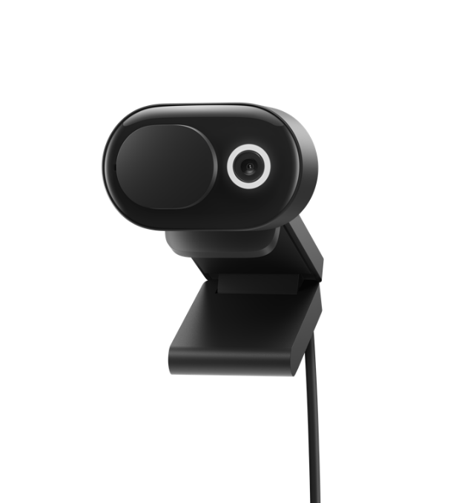
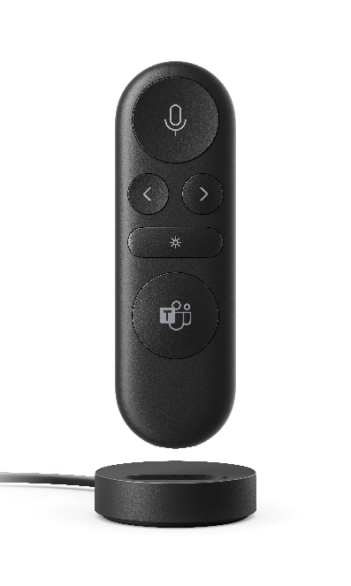
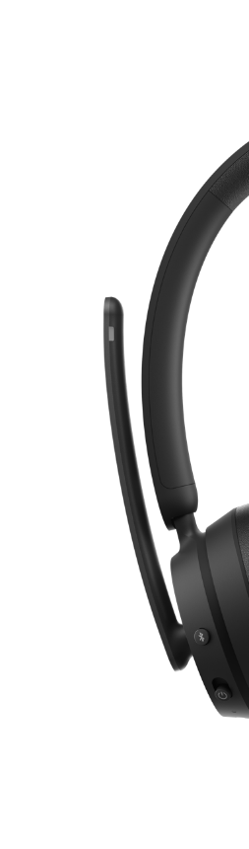
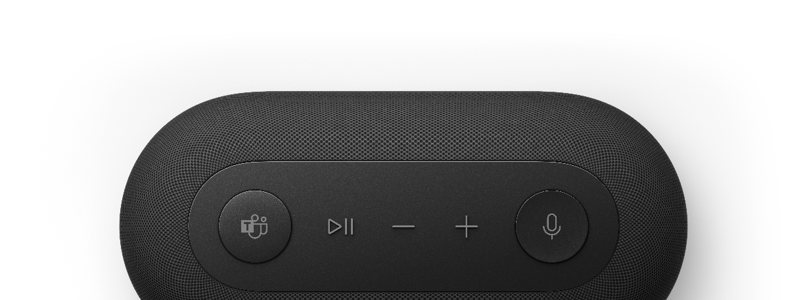
Accessories certified
for Microsoft Teams
Stay connected
Notes:
Note: Relevant disclaimers are included in slide notes throughout this presentation, along with additional narrative.​

Slide 2
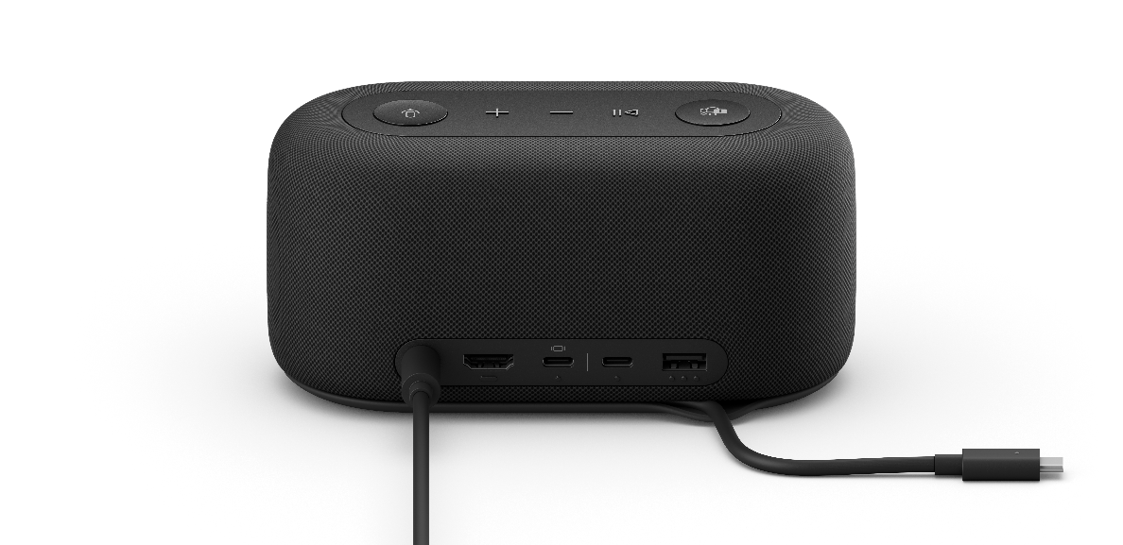
Flexible work is the new normal
But it can be challenging to meet in the moment
Teams need flexible, productive, and secure
work-from-anywhere options
Evolving calling scenarios require modern solutions and legacy features
Added digital and real-life distractions inhibit meeting productivity
People struggle to feel connected to colleagues
Notes:
Digital transformation is fast becoming the lifeblood of every business, every industry.
Businesses today must innovate around how work gets done, where it gets done, and the software and solutions needed to enable it all. Simply put, the way we work has changed—remote and hybrid work are the new norm, and they can bring many benefits, but not without challenges:
Teams need flexible, productive, and secure work from home options—30% of workers have an increased sense of burnout.​¹
Businesses need to adapt to new calling scenarios but also maintain traditional communications like phone calls.
People are struggling to meet productively due to increased digital and real-life distractions like the always-open browser or when the dog or kids run in.
Despite having more empathy for coworkers, 60% of people we surveyed said they feel less connected to their colleagues since moving to remote work.² ​
--
¹Microsoft, “A pulse on employees’ wellbeing, six months into the pandemic”, 2020.
²Microsoft, “The future of work – the good, the challenging & the unknown”, 2020.

Slide 3
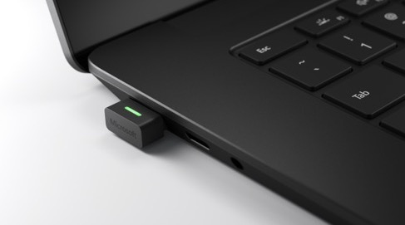
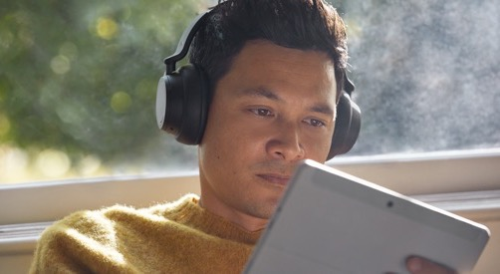

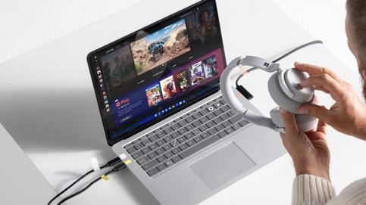
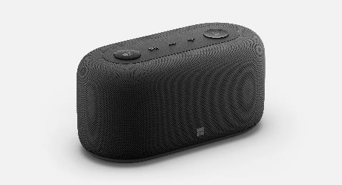
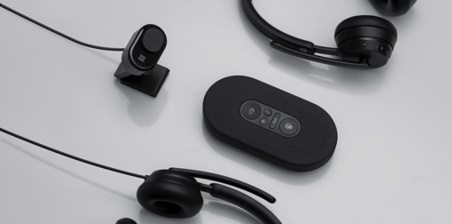

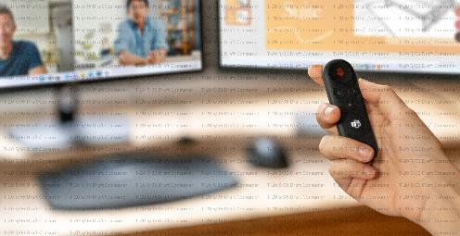

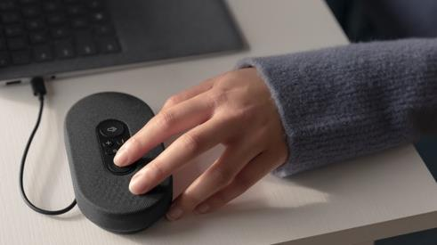
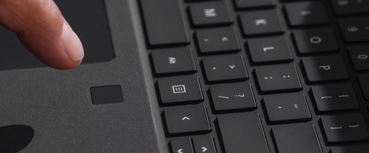
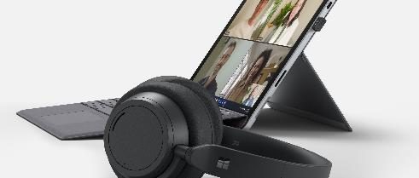
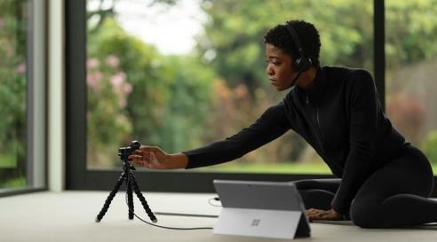
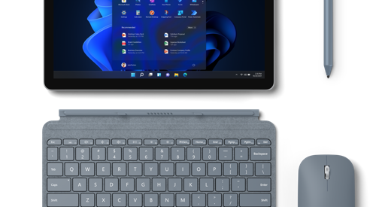
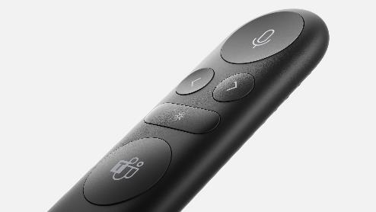
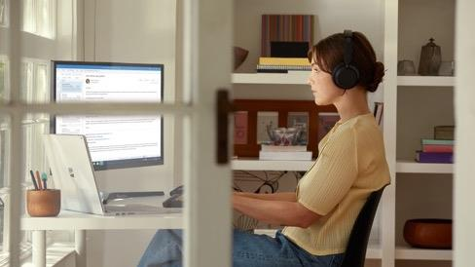
Connection and collaboration are required for business resilience
Notes:
Our CEO Satya Nadella said, “The next decade of economic performance for every business will be defined by the speed of their digital transformation.”
Part of digital transformation is finding ways to make people feel more connected wherever they are, to enable serendipitous problem-solving, and to provide solutions that allow people to stay in the flow and minimize distractions.
In other words, creating better connection and collaboration isn’t just good for your people—it’s a business imperative.

Slide 4
Microsoft Teams
Accomplish more together
Chat
Share your status, your opinion, and your personality in group chats or one-to-one messages
Meet
Teams of two or 10,000 can meet in one place, no matter how many locations they’re in
Call
Make and receive calls with internal and external groups across systems and services
Collaborate
Easily find, share, and edit files in real time using familiar Microsoft 365 apps
Notes:
Accomplishing more together—now and beyond the pandemic—requires software and solutions. Unlike point solutions for communications or collaboration, we believe our approach to teamwork provides a more holistic solution for our customers.

Slide 5
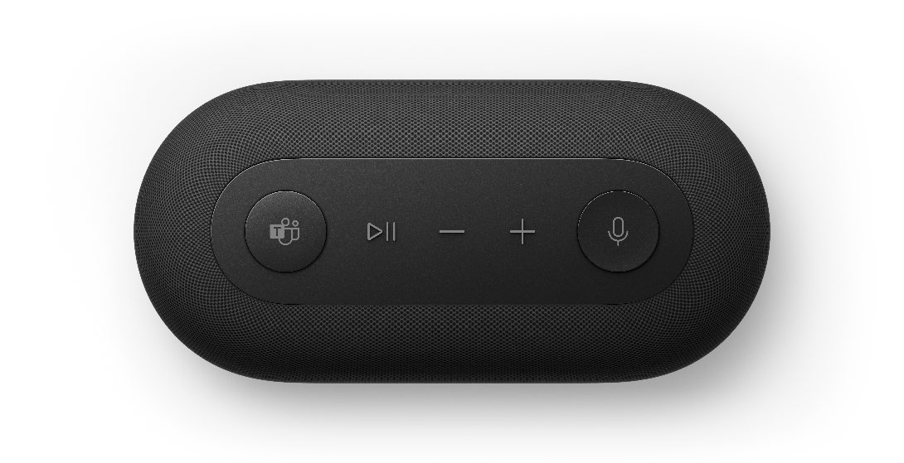
Growth to match the moment
Daily active users of Microsoft Teams have nearly tripled since March 2020
44
million DAU in March 2020³
75
million DAU in April 2020³
115
million DAU in October 2020⁴
145
million DAU in April 2021⁵
I was surprised at the increased personal connection we get with customers through Teams meetings. We see people in their personal surroundings, working from home. It’s helping us get to know our clients on a completely different level.
Scott DeMeulemeester
Managing Director (Slalom)
“”
Notes:
And businesses agree. Since the pandemic, Teams has grown to over 145M daily active users as of April 2021. Microsoft Teams is designed to help people stay connected, collaborate seamlessly, and simplify work, in a secure and compliant way—all in one place. In short, Teams is where people come together to get work done.​
Global consulting firm Slalom fully adopted Teams to stay resilient during the pandemic but soon realized many unexpected benefits. They found that Teams did more than help them maintain their client relationships—it helped enhance them.
--
³Business Insider, "Microsoft Teams Now Has 75 Million Daily Active Users", 2020.
⁴Microsoft, “Microsoft Teams reaches 115 million DAU—plus, a new daily collaboration minutes metric for Microsoft 365”, 2020.
⁵Microsoft, Microsoft Fiscal Year 2021 Third Quarter Earnings Conference Call, 2021.

Slide 6
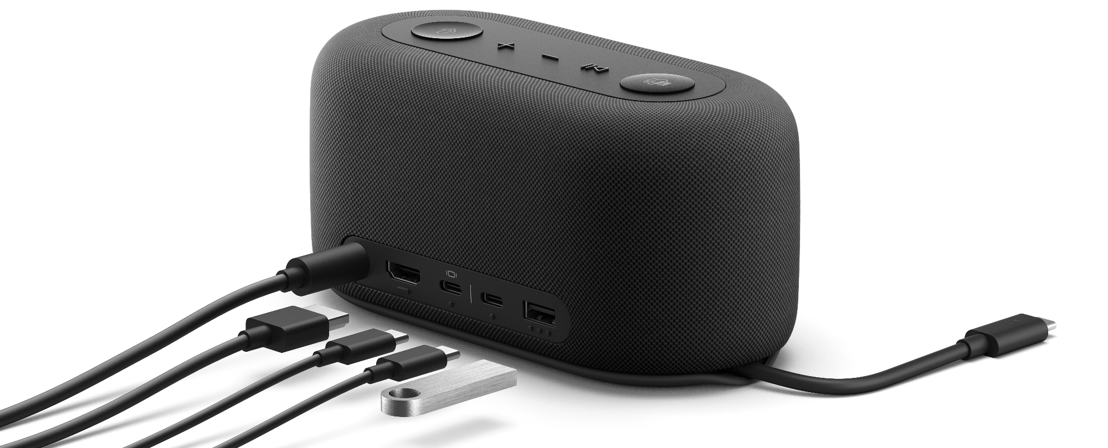
Accessories certified for Microsoft Teams make connecting virtually a seamless, reliable, and rich experience.
Notes:
No matter how good the software is, devices matter too. Poor-quality mics, speakers, and cameras impede your team’s ability to connect and get work done. Premium, integrated devices complete the equation—removing obstacles to smooth, productive meetings.
Accessories certified for Teams optimize the experience so you can start and join meetings seamlessly, hear and be heard clearly, and enhance the Teams collaboration experience wherever you work.

Slide 7
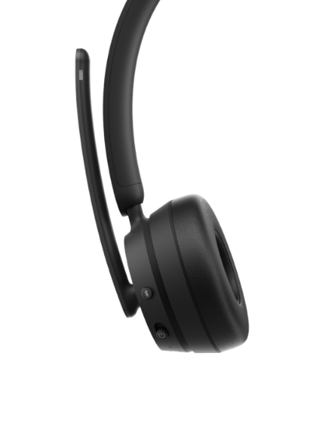
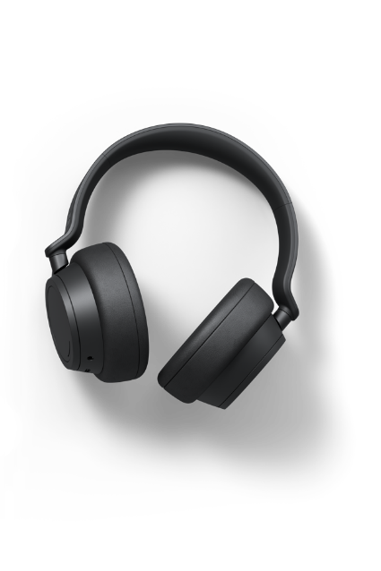
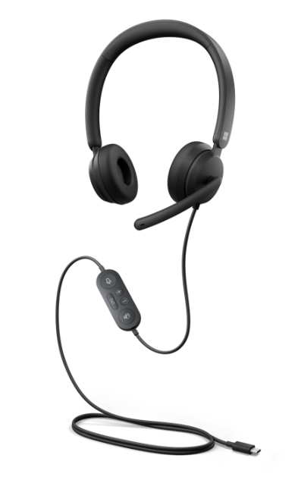
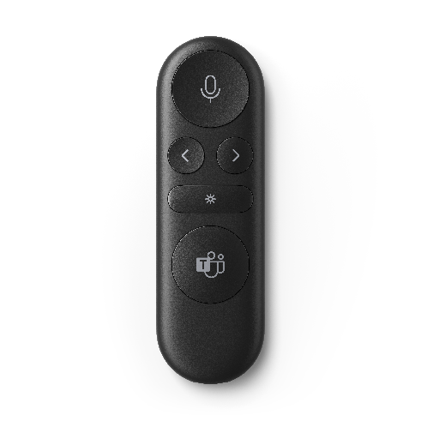

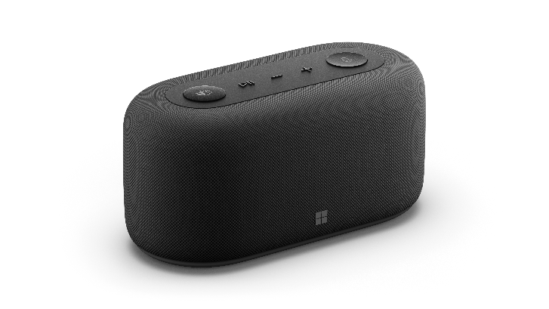
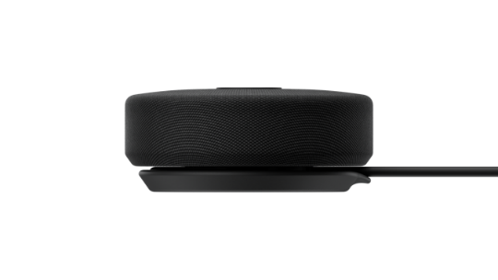
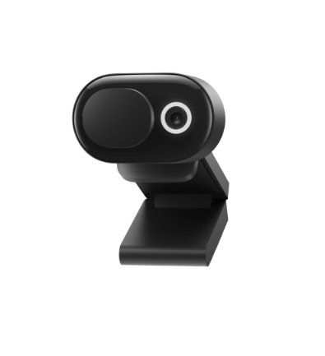
Accessories certified for Microsoft Teams
Optimized for Teams, designed for you
Quality
High-quality audio, video, and sharing experiences on any device, in any space
Rigorously tested
Tested to meet Teams certification standards so that meetings just work
Rich integration
Built to plug-and-play with integrated call controls, a dedicated Teams button, and LED indicators
Accessories not to scale
Notes:
Introducing our line of accessories certified for Microsoft Teams. Each of these devices was developed in partnership with our Teams software engineers to make your Teams calling experience seamless and integrated. And all of them are built to deliver on core pillars of Teams certification:
Certified accessories meet high-quality standards to make you look and sound your best:
That means wide-band audio with no echo, distortion, or excessive glitches—and echo cancellation is also supported across devices.
And video devices adhere to quality requirements for noise, color, image detail, jitter, latency, frame rate, and field of view.
All accessories are built to meet our rigorous standards and are backed by Microsoft support.
And all our accessories are made for rich Teams integration and simple plug-and-play usability, so devices just work.

Slide 8
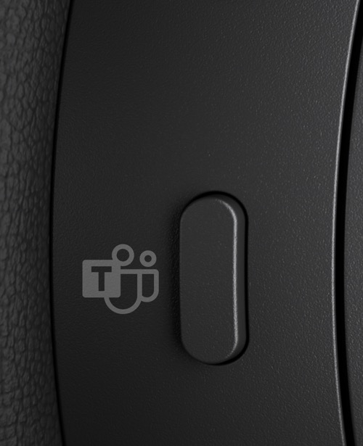
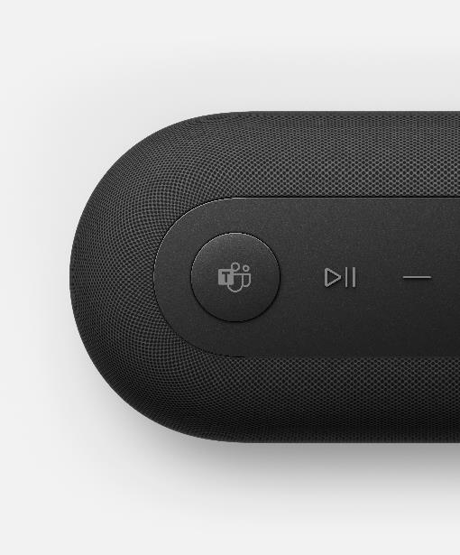
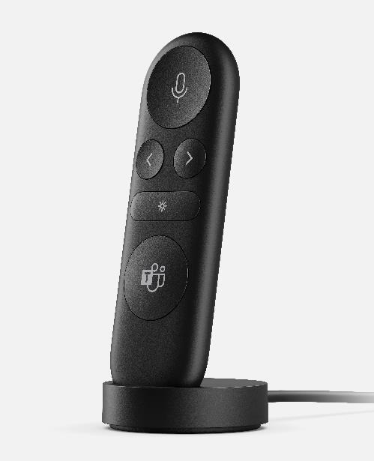
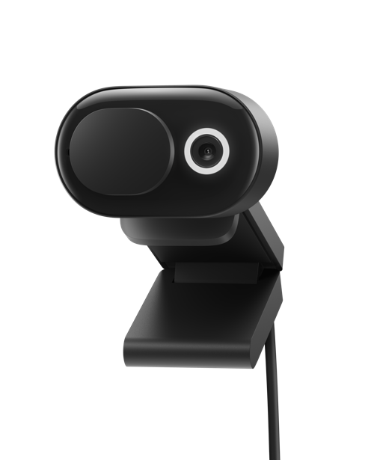
Details make the difference
Features that bring the certified for Microsoft Teams experience to life
Join your next meeting with the click of a button
Expand your connections
Hear and be heard clearly
Present like a pro in person or online
Join the conversation—when you’re ready
Easy setup⁶
Notes:
But what does Teams certification look like? How does it play out when it comes to our hardware? The difference is in the details. In practical terms it means:
An integrated Teams button so you can join your next meeting in one move.
Connecting more easily to your accessories as well as hearing and being heard with clarity.
The ability to present like a pro and join the conversation when you’re ready to be heard.
Accessories that easily work across devices—no setup required.
--
⁶Compatibility tech specs:
Microsoft Surface Headphones 2+ compatibility: Bluetooth® (without Microsoft Surface USB Link): Windows 11 Home/Pro, Windows 10, Android 11/10/9, iOS 14/13/12, macOS 11/ 10.14, Bluetooth® 5.0/4.2/4.1. With Microsoft Surface USB Link: Windows 11 Home/Pro, Windows 10, macOS 11/10.14, Bluetooth® 5.0
Microsoft Audio Dock compatibility: With USB-C: Windows 11 Home/Pro, Windows 10, MacOS 11/12 Conference Software*: Microsoft Teams, Zoom, Google Meet
Microsoft Presenter+ compatibility: Bluetooth®: Windows 11, Windows 10, MacOS 11/12. Device must support Bluetooth® 4.0 or Higher Conference Software*: Microsoft Teams, Zoom, Google Meet Presentation Software*: Microsoft PowerPoint, Prezi, Keynote, etc.
Microsoft Modern Webcam compatibility: Windows 11 Home/Pro, Windows 10, Mac OS (11.0/10.15), Windows 8.1/8. Some features, and microphone, require software download (storage required); not supported on Mac OS.
Microsoft Modern USB-C® Speaker compatibility: Windows 11 Home/Pro, Windows 10, Windows 8/8.1, Mac OS X 10.15, Mac OS 11.0

Slide 9


Microsoft Audio Dock
All-in-one speakerphone, dock, and power
Immediately connect to external monitors, power, and a speakerphone with a single plug. Microsoft Audio Dock is a flexible, simplified desktop setup solution made for productivity in flexible workspaces.
Four ports including HDMI, two USB-C, one USB-A, and power pass-through
Exceptional voice capture and less background sound from dual forward-facing, noise-reducing microphone
Multi-dimensional sound with built-in Omnisonic® speakers for premium audio quality
Stay organized with the compact hub design set neatly on your desktop to help reduce clutter
Notes:
Meet Microsoft Audio Dock—the all-in-one speakerphone, dock and power supply made for flexible workspaces.
Simplify your desk setup with the compact hub that sits neatly on your desk to reduce clutter.
Includes an HDMI, 2 USB-C, and one USB-A port to connect up to four accessories including your monitor—plus a power pass through to change your Surface device.
Dual forward-facing microphones capture your voice, but not background noise.
Omnisonic® speakers provide premium, multi-dimensional audio quality.
Compatible with the apps you use today. Enjoy exceptional performance with online meeting and streaming apps.*
--
*Some accessories and software sold separately.

Slide 10
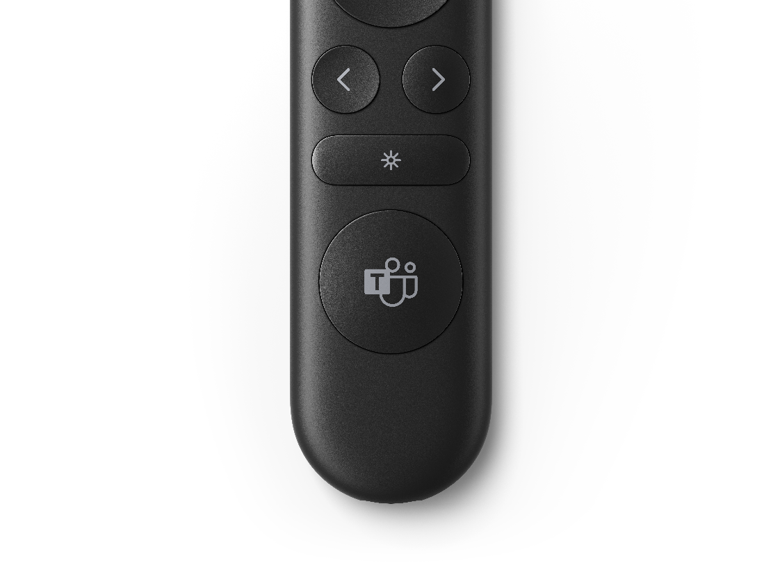
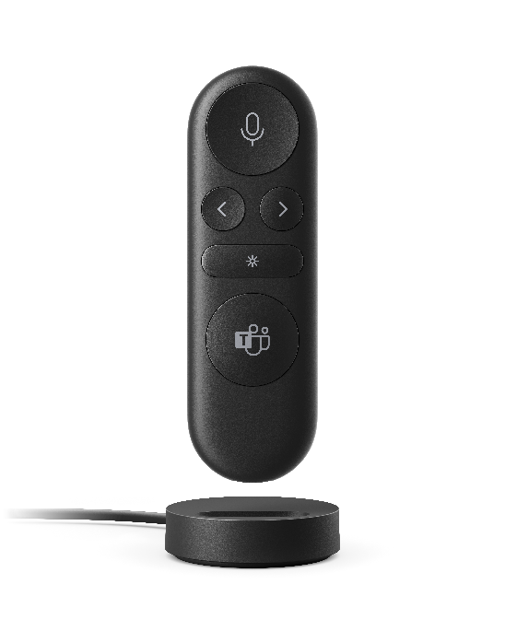
Microsoft Presenter+
Present, participate, and control meetings
Confidently deliver engaging presentations and participate in meetings, in person or online, with the push of a button. Effortlessly advance slides, focus audience attention on key content, and quickly mute/unmute. Certified for Microsoft Teams.
Advance slides, go back, and direct your audience’s attention with the screen pointer when using PowerPoint Live*
Integrated mute control with status light ensures you don’t get caught talking to yourself
Quickly join a meeting and raise your hand to participate with the integrated Microsoft Teams button
Bluetooth connectivity, wireless range up to 10m (32.8ft) in an open area, slim design, and up to 6 days of battery life⁷
Notes:
Introducing Microsoft Presenter+. Confidently deliver engaging presentations and participate in meetings, in person or online.
Effortlessly advance slides, focus audience attention on key content with the screen pointer when using PowerPoint.*
Quickly join meetings and raise your hand with the integrated Microsoft Teams button.
Integrated mute control with status light ensures you know when you’re muted or not.
Bluetooth® connectivity gives you the power to present from anywhere in the room, with wireless range up to 10m (32.8ft) in an open area, and up to 6 days of battery life.⁷
--
*Some accessories and software sold separately.
⁷Battery life varies significantly based on usage, settings and other factors. Testing conducted by Microsoft in September 2022 using preproduction devices. Testing consisted of connecting each device to a host via Bluetooth and measuring battery discharge associated with a mixture of active use and standby scenarios. All settings were default settings.

Slide 11
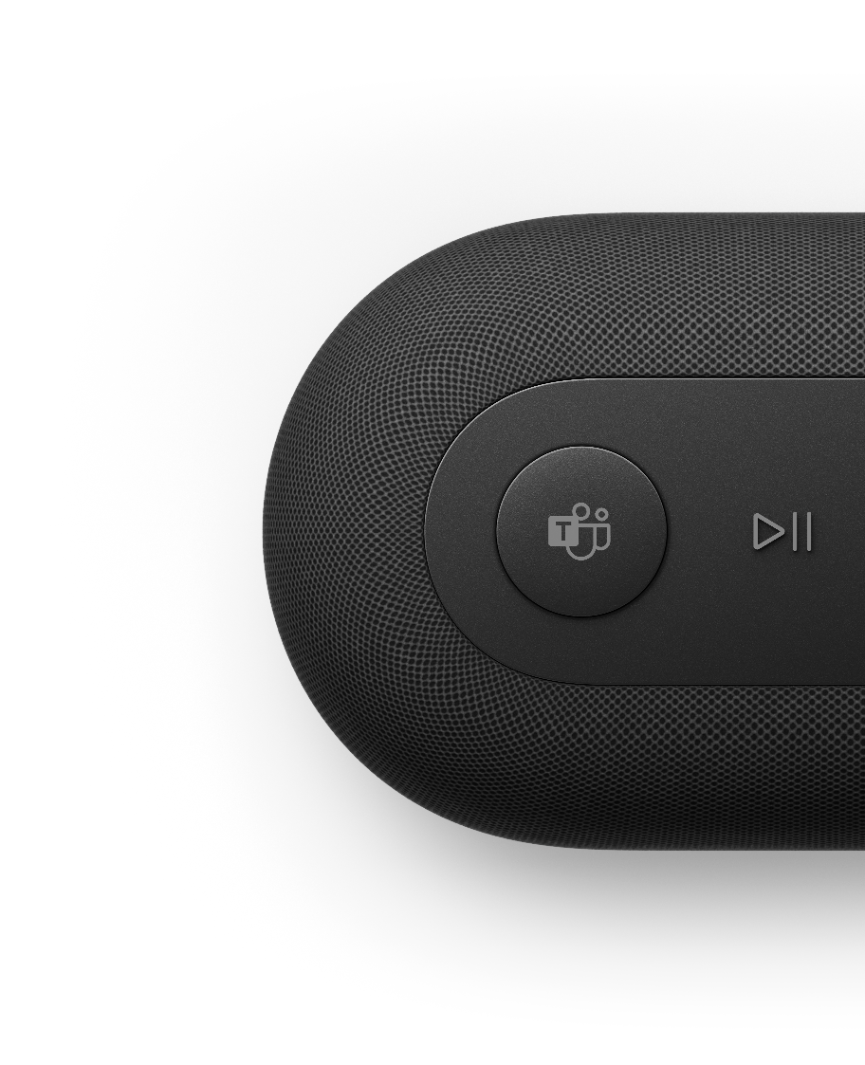
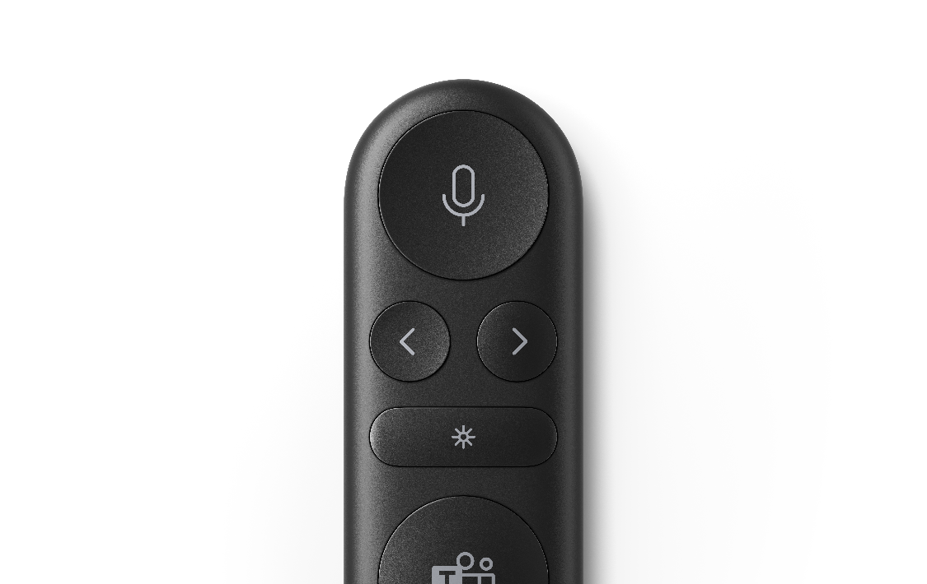
Thank you

Slide 12
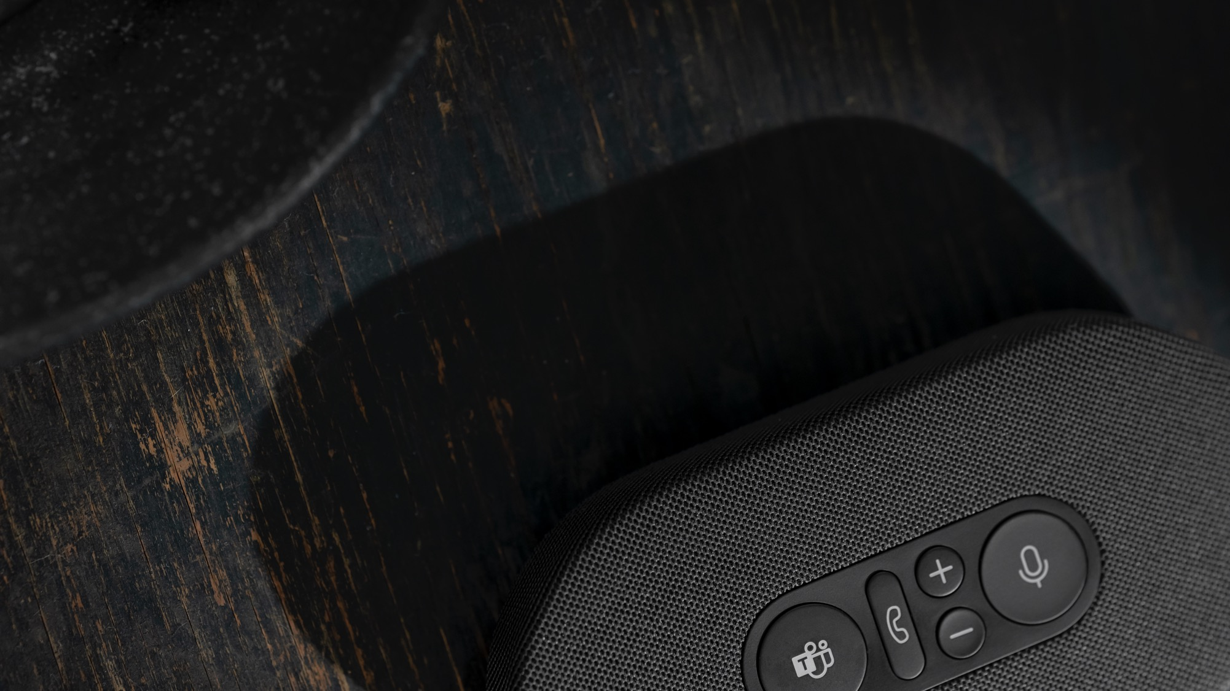
Appendix

Slide 13
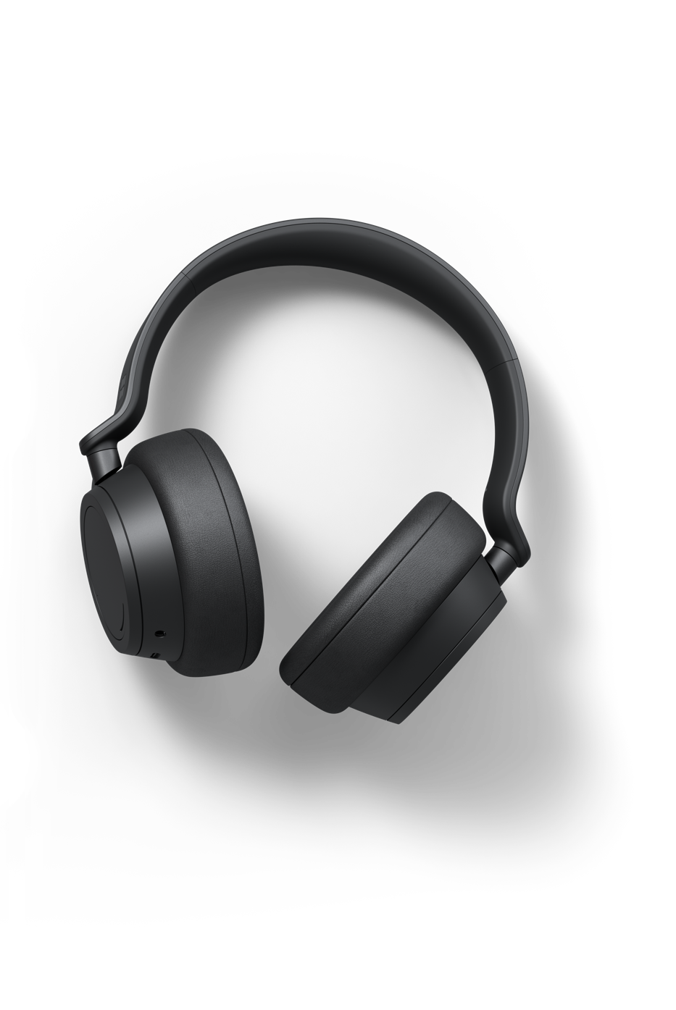
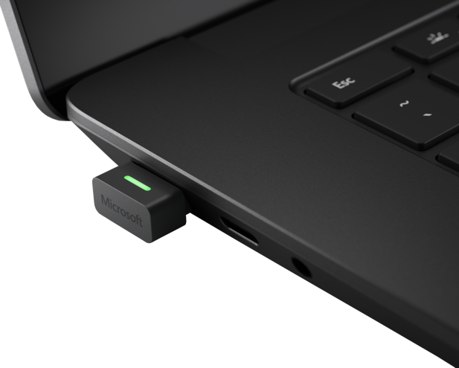
Microsoft Surface Headphones 2+
The smarter way to connect
Empower your team with immersive,
high-quality calls and distraction-free focus. Depend on a reliable connection during calls and interact with intuitive touch controls—Microsoft Surface Headphones 2+ are certified for Microsoft Teams⁸ with or without the Microsoft Surface USB Link, giving you more convenience during hybrid work life.
13 levels of active noise cancellation to tune in or out for focus anywhere
Be heard loud and clear with our advanced 8-microphone system
Comfortable over-ear fit and battery life that lasts up to 15 hours of voice calling time⁹
Amplify your productivity with the power of voice in Microsoft 365^{10, 11}
Notes:
Meet Microsoft Surface Headphones 2+—the smarter way to connect. Imagine:
Plugging the Microsoft Surface USB Link directly into your PC to create an instant, reliable connection.
Joining a Teams meeting and controlling volume and 13 levels of active noise cancellation using intuitive, on-ear controls.
Hearing your teammates—and being heard—with crystal clarity.
Using your voice to get more done like dictating an email or managing your Outlook inbox.
--
⁸Microsoft Teams certification on Surface Headphones 2+ with native Bluetooth for Microsoft Teams can be achieved with or without the Surface USB Link; only available on Windows and MacOS. Firmware update 1.0.7.44 is ready to download for Windows 11, Windows 10 release will start rolling out soon. Availability may vary by market and device; see https://aka.ms/Surface_Headphones_2plus_Firmware_Update for details.
⁹Voice calling testing conducted by Microsoft in February 2021 using prerelease Surface Headphones + Dongle package with prerelease software. The dongle was plugged into Surface Laptop 3 and/or Surface Pro 7. Volume was set to 52% with maximum noise cancellation. Bluetooth® Hands-Free profile was used. Testing consisted of full Surface Headphones battery discharge with a Microsoft Teams call until the Surface Headphones disconnected from the host device. Battery life depends on device settings, environment, usage, and many other factors.
¹⁰Software license required for some features. Sold separately.
¹¹Find out more about Microsoft Surface Headphones 2+ voice interactions with Microsoft 365 apps at https://support.microsoft.com/en-us/surface/use-microsoft-365-with-surface-headphones-917d98c2-7495-a6cf-97f8-e1b594e8ce7c. Voice controls vary by operating system.

Slide 14

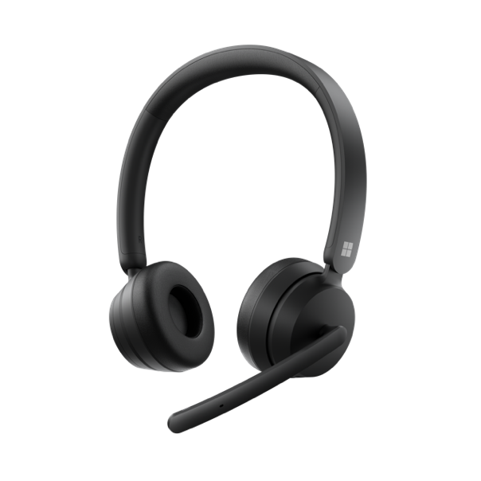
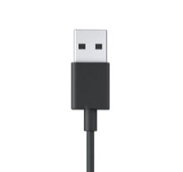
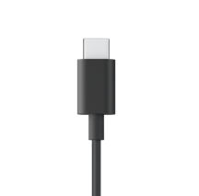
Microsoft Modern
USB-C® Headset
Microsoft Modern Wireless Headset
Microsoft Modern
USB Headset
Connect seamlessly—and wirelessly¹²—to your Surface or other Windows 11 or 10 PC** while delivering extra mobility, superior audio, and simple, on-ear call controls.​ Flip-to-mute microphone with status light lets you see at a glance whether you can be heard or not.
Connect fast and stay focused thanks to high-quality audio and voice, noise-reducing microphone, and intuitive, in-line call controls in Microsoft Teams and more. Get the choice between either a USB-A or USB-C® connection for even more plug-and-play versatility.***​
Comfortable
on-ear design
Background
noise-reducing microphone
High-quality stereo speakers
Intuitive call controls
Notes:
We also offer Microsoft Modern USB Headset and Microsoft Modern Wireless Headset—two more high-quality audio solutions—both certified for Microsoft Teams.
Background noise-reducing microphones help you stay focused no matter your environment.
Check your mute status at a glance on Microsoft Modern USB Headset’s built-in light.
Get up, walk around, or get a drink from the fridge during your calls with Microsoft Modern Wireless Headset.
--
**Sold separately. Subscription may be required.
***Microsoft Modern USB-C® Headset and Microsoft Modern USB Headset sold separately.
¹²Microsoft Teams certification for Microsoft Modern Wireless Headset requires plugging the included USB dongle into your PC.

Slide 15
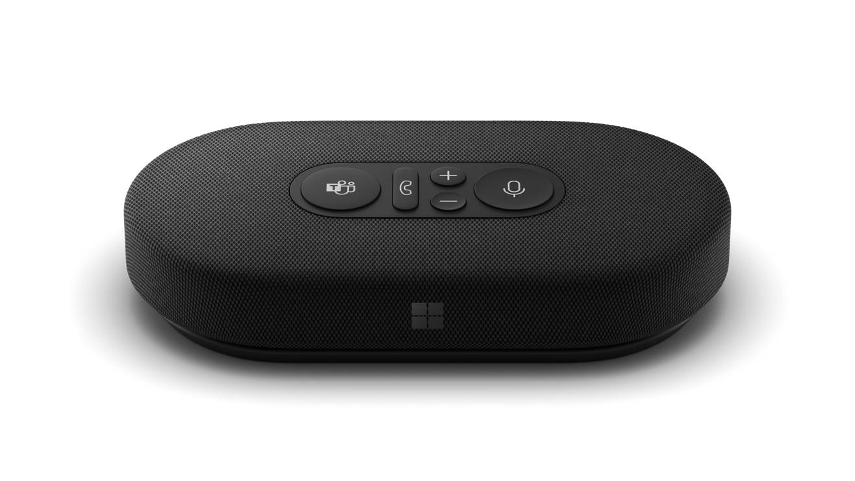
Microsoft Modern USB-C Speaker
Your workday audio companion for better calls and music
Add high-quality audio to your workspace wherever you are. Certified for Microsoft Teams, Microsoft Modern USB-C Speaker seamlessly integrates¹³ with your Surface or other Windows 11 or 10 PC¹⁴ for clear, reliable calls and great sound for music.
Intuitive meeting controls, with mute button and status indicator
Omnidirectional, background noise-reducing microphone
High-quality speaker optimized for voice
Premium, compact
design with cable storage and carrying case
Notes:
Wherever you work, add reliable, high-quality audio to your laptop space with Microsoft Modern USB-C Speaker.
Take a call in your kitchen or office huddle space to hear audio while you’re away from your device—Microsoft Modern USB-C Speaker will pick up your voice across the room.
Compact and easy to carry, slip Microsoft Modern USB-C® Speaker in your bag and take it with you.
--
¹³Microsoft Modern USB-C Speaker connects to your device via USB-C® connection.
¹⁴Compatible with Windows 11 Home/Pro and Windows 10 with latest updates. Some software, hardware, and accessories sold separately.

Slide 16
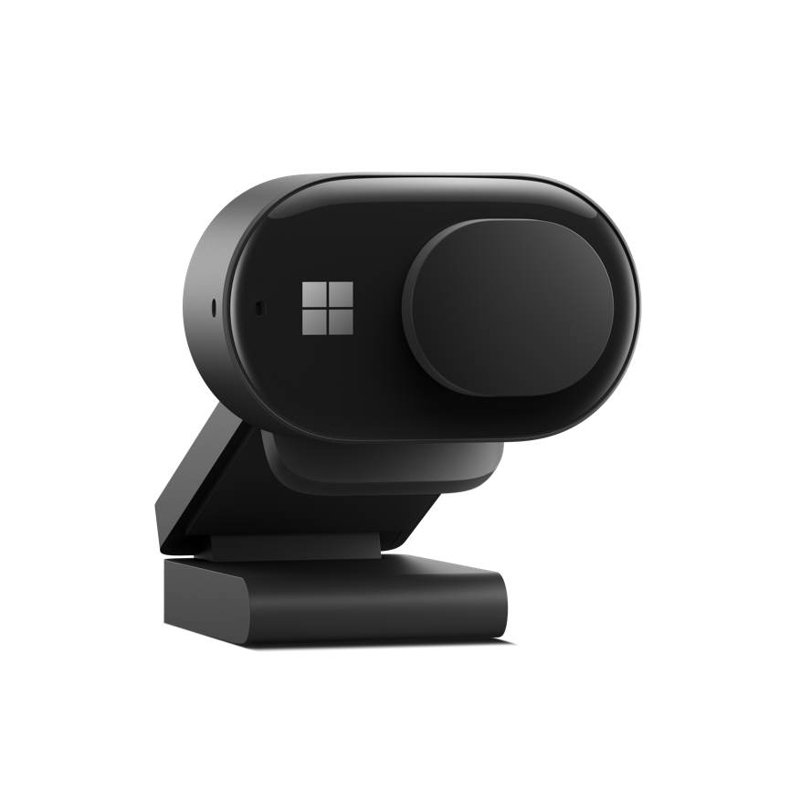
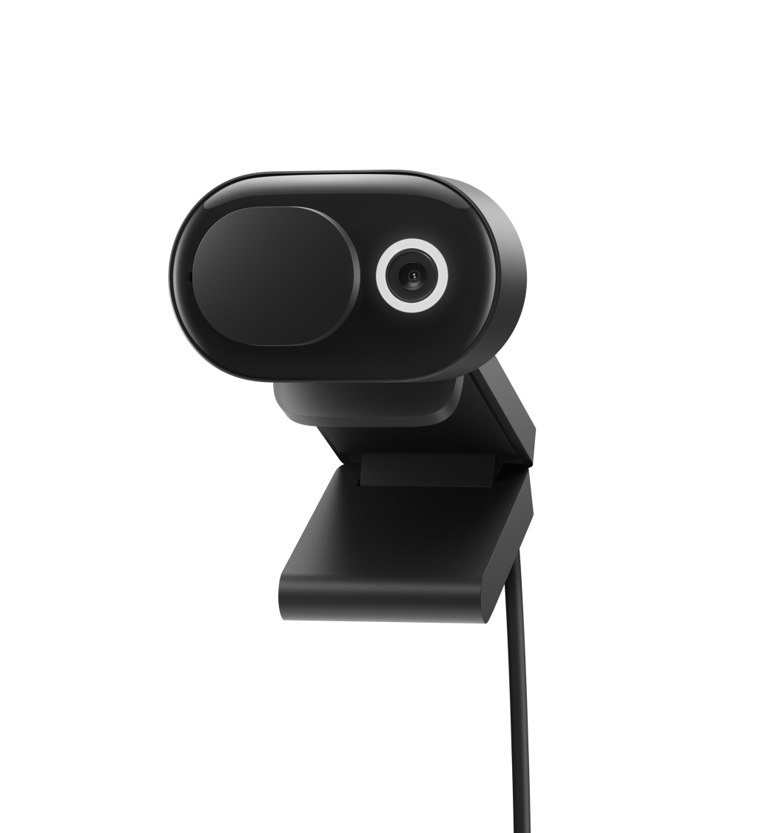
Microsoft Modern Webcam
High-quality videoconferencing for Microsoft Teams
Look your best on face-to-face calls and Microsoft Teams meetings. FHD camera with versatile, easy-to-mount system adds reliable, high-quality video to your laptop workspace.¹⁵ Featuring high-quality video with HDR and True Look.
Facial retouch and auto light adjustment
Integrated privacy shutter and LED usage indicator
Versatile mounting system
Up to 1080p video and expansive 78° field of view
Notes:
At home or the office, add reliable, high-quality video to your workspace with Microsoft Modern Webcam.
Easily mount Microsoft Modern Webcam to your monitor, laptop, desk, or tripod.*
Use the privacy shutter and built-in Microsoft Teams controls to easily turn video on and off.
--
*Some accessories and software sold separately.
¹⁵Microsoft Modern Webcam is compatible with Windows 11 Home/Pro, Windows 10, Mac OS 11.0/10.15, and Windows 8.1/8. Some features require software download (storage required); not supported on Mac OS.

Slide 17
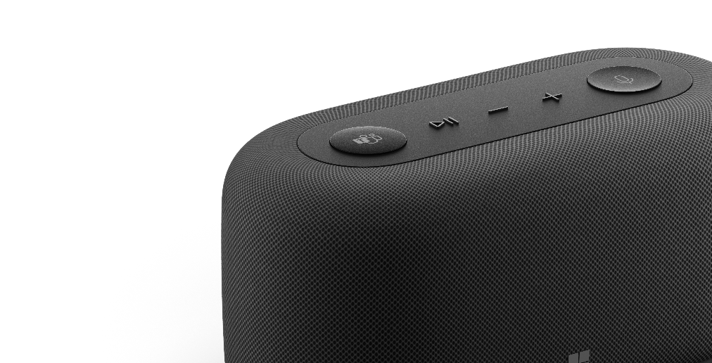
Microsoft Audio Dock
Dimensions | Width: 167.6 mm Depth: 80.2 mm Height: 81 mm (6.6 x 3.16 x 3.19 in)
Weight | 650 g (22.9 oz.) (Package not included)
Connection to PC | USB-C
USB cord length | 1 meter (39.4 in.)
Dock connections | 1 USB-C® (USB3.1 Gen 2, power up to 7.5 W) - support DP alt mode, up to Dual Display¹⁶ 1 USB-C® (USB3.1 Gen 2 data only, power up to 7.5 W) 1 USB-A 3.2 (USB3.1 Gen2) 1 HDMI 2.0 port with 4K@60Hz Support MST in USBC and HDMI port Support USBC PD charging (up to 60 W)
Colors | Matte Black
Compatibility | Operating System: Windows 11 Home/Pro, Windows 10, MacOS Conference Software: Microsoft Teams, Zoom, Google Meet
Microphone | Two omni-directional microphone arrays
Speakers (qty) | Tweeter: OD25.9 x H11.6mm Woofer: L54 x W48.8 x H41.5mm
Sound pressure level output | Up to 90dB SPL
Audio codec | Codec RK2108 Amp TAS5805
Frequency response | 70Hz~20kHz for music playback 200Hz~8kHz for conference
Button and controls | Microsoft Teams button Mute button Volume up button
Microsoft Accessory Center | Speaker performance customization and microphone settings (Available only on Windows)
What’s in the box | Microsoft Audio Dock (Ramba) Power Supply Unit and AC cord Quick Start Guide Safety and warranty documents
Warranty¹⁷ | 1-year limited warranty
Notes:
*Some accessories and software sold separately.
¹⁶Dock could support dual 4k@60Hz display If host supports DSC.
¹⁷Microsoft’s Limited Warranty is in addition to your consumer law rights.

Slide 18
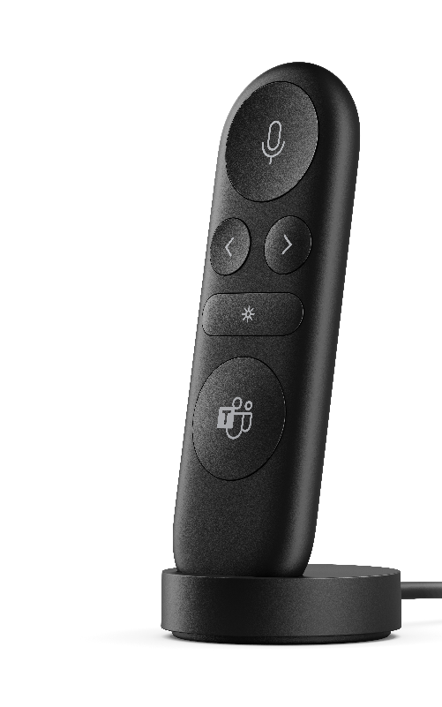
Microsoft Presenter+
Dimensions | 93.86 x 29.5 x 9.4 mm (3.7 x 1.16 x .35 in)
Weight | 25.6g (.90 oz) (including batteries) (Package not included)
Rechargeable battery | Max 4.45V 195mAh Li-ion Battery
Colors | Matte Black
Connections | Wireless
Color | Matte Black
Interface | Bluetooth® Low Energy 5.1
Wireless frequency | 2.4GHz frequency range
Wireless range | 10m (32.8ft) in open area; up to 5m (16ft) in typical office environment
Compatibility | Operating System: Windows 11, Windows 10, MacOS 12 Device must support Bluetooth® 4.0 or Higher Conference Software: Microsoft Teams Presentation Software: Microsoft PowerPoint, Prezi, Keynote, etc.
Battery life¹⁸ | Up to 6 days
Charge time | 2hrs
Battery charging | USB-A charging dock (included in box) Supports direct USB-C input to charge (cable not included)
Battery life indicator | Red LED to show the low battery mode White LED to show battery is in charging or full charge
Button and controls | Microsoft Teams button Mute button Left navigation button Right navigation button Pointer button Bluetooth pairing button Power slider Programmable button: Left navigation button, right navigation button
Microsoft Accessory Center** | Set your preferences for haptic feedback and customize programmable buttons for a personalized experience
What’s in the box | MS Presenter+(Clicker) USB-A charging dock Quick Start Guide Safety and warranty documents
Warranty | 1-year limited warranty
Notes:
*Some accessories and software sold separately.
**Available exclusively on Windows 10 and 11 devices. Use the Microsoft Accessory Center to customize Akron and set preferences for haptic feedback.
¹⁷Microsoft’s Limited Warranty is in addition to your consumer law rights.
¹⁸Battery life varies significantly based on usage, settings and other factors. Testing conducted by Microsoft in September 2022 using preproduction devices. Testing consisted of connecting each device to a host via Bluetooth and measuring battery discharge associated with a mixture of active use and standby scenarios. All settings were default settings.

Slide 19
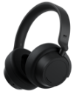





High-quality audio for calls and more
Compare headsets certified for Microsoft Teams
 |  | Microsoft Surface Headphones 2+ | Microsoft Modern Wireless Headset | Microsoft Modern USB Headset | Microsoft Modern USB-C® Headset
Certified for Microsoft Teams |  | ● | ● | ● | ●
Wireless |  | ● | ● | - | -
Band type |  | Over the ear | On ear | On ear | On ear
Audio |  | Omnisonic™ Stereo Sound | Stereo | Stereo | Stereo
Modern, boomless design |  | ● | - | - | -
High-quality audio codec |  | SBC and aptX™ (without dongle) | - | - | -
Speaker |  | 40 mm Free Edge driver | 28 mm moving-coil speaker driver | 28 mm moving-coil speaker driver | 28 mm moving-coil speaker driver
Battery life |  | Up to 15 hours talk time⁹ | Up to 30 hours talk time¹⁹ | N/A | N/A
Active noise cancellation |  | Adjustable (13 levels) | - | - | -
Microphone(s) |  | 8 microphone-array (4 per earcup) | 1 Unidirectional Boom with noise reduction for voice clarity | 1 Unidirectional Boom with noise reduction for voice clarity | 1 Unidirectional Boom with noise reduction for voice clarity
Controls |  | Capacitive touch, dials, buttons | On ear cup | In-line on controller | In-line on controller
Connection type |  | Wireless, USB-A, 3.5 mm audio | Wireless, USB-A | Wired, USB-A | Wired, USB-C®
Adjustable headband |  | ● | ● | ● | ●
Wear detection |  | ● | - | - | -
USB-A Bluetooth® receiver |  | ● | ● | - | -
3.5 mm audio |  | ● | - | - | -
Notes:
⁹Voice calling testing conducted by Microsoft in February 2021 using prerelease Surface Headphones + Dongle package with prerelease software. The dongle was plugged into Surface Laptop 3 and/or Surface Pro 7. Volume was set to 52% with maximum noise cancellation. Bluetooth® Hands-Free profile was used. Testing consisted of full Surface Headphones battery discharge with a Microsoft Teams call until the Surface Headphones disconnected from the host device. Battery life depends on device settings, environment, usage, and many other factors.
¹⁹Voice: Testing conducted by Microsoft on March 2021 using Microsoft Modern Wireless Headset at peak power consumption (mA) conditions on a Microsoft Teams call. These conditions for Microsoft Moderns Wireless Headset are when 100% of usage is muted, and both the red and white LEDs are lit at the same time.

Slide 20





A headset for every workspace
Microsoft Surface Headphones 2+
Widest range of environments due to powerful active noise cancellation for focus anywhere, boomless design, and seamless use with PC and mobile alike^{8,20}
Microsoft Modern Wireless Headset
Call centers | Personal office | Home office | Open office or noisy environments | Executive office
Microsoft Modern USB Headset and
Microsoft Modern USB-C® Headset
Notes:
⁸Microsoft Surface Headphones 2+ require use of the included Microsoft Surface USB Link to achieve Microsoft Teams certification, only available on Windows and macOS.
²⁰PC and mobile devices sold separately.

Slide 21


A headset for every role
Microsoft Surface Headphones 2+
Microsoft Modern Wireless Headset
Teleworker | Customer relationship manager | Roaming customer service | Mobile sales representatives | Information workers | Engineers, designers, researchers | Executives
Microsoft Modern USB Headset and
Microsoft Modern USB-C® Headset

Slide 22

Microsoft Surface Headphones 2+
Dimensions | Length: 8.03” (204 mm) Width: 7.68” (195 mm) Depth: 1.89” (48 mm)
Weight | 0.64 lb. (290 g)
Exterior | Colors: Matte Black
Frequency response | 20Hz–20kHz
Noise cancellation | Up to 30 dB for active noise cancellation Up to 40 dB for passive noise cancellation
Speaker | 40 mm Free Edge driver
Sound pressure level output | Up to 115 dB (1kHz, 1Vrms via cable connector with power on) Up to 115 dB (1kHz, 0dBFS over Bluetooth® connection)
Battery life | Up to 18.5 hours of music listening time²¹ or up to 15 hours of voice calling on Microsoft Teams⁹
Charging | Full charge in less than 2 hours
USB cord length | 1.5 m
Audio cable length | 1.2 m
Inputs | Headphones: USB-C® connector, 3.5 mm audio connector Microsoft USB Link: USB-A or USB-C^{®22}
Sensors | Wear detection sensors on earcups Touch sensors on earcups
Compatibility | Bluetooth® (without Microsoft Surface USB Link): Windows 11 Home/Pro, Windows 10, Android 11/10/9, iOS 14/13/12, macOS 11/10.14, Bluetooth® 5.0/4.2/4.1 With Microsoft Surface USB Link: Windows 11 Home/Pro, Windows 10, macOS 11/10.14, Bluetooth® 5.0
Audio codec | SBC and aptX™²³
Buttons and controls | Power button Microsoft Teams button Volume dial (right ear) Noise Cancellation dial (left ear) Single earcup tap (Mute)
What’s in the box | Microsoft Surface Headphones 2+ Carrying case USB cable Audio cable Microsoft USB Link (USB-A) Quick Start Guide Safety and warranty documents
Warranty¹⁷ | 1-year limited hardware warranty
Notes:
⁹Voice calling testing conducted by Microsoft in February 2021 using prerelease Surface Headphones + Dongle package with prerelease software. The dongle was plugged into Surface Laptop 3 and/or Surface Pro 7. Volume was set to 52% with maximum noise cancellation. Bluetooth® Hands-Free profile was used. Testing consisted of full Surface Headphones battery discharge with a Microsoft Teams call until the Surface Headphones disconnected from the host device. Battery life depends on device settings, environment, usage, and many other factors.
¹⁷Microsoft’s Limited Warranty is in addition to your consumer law rights.
²¹Music listening testing conducted by Microsoft in February 2021 using prerelease Surface Headphones + Dongle package with prerelease software. The dongle was plugged into Surface Laptop 3 and/or Surface Pro 7. Playlist consisted of 44 songs transmitted using SBC encoding. Volume was set to 46% with maximum noise cancellation. Bluetooth® A2DP profile was used. Testing consisted of full Surface Headphones battery discharge while playing audio until the Surface Headphones disconnected from the host device. Battery life depends on device settings, environment, usage, and many other factors.
²²USB-A to USB-C® adapter should work for a C-capable source. Performance varies based on the quality of the adapter and the cable length.
²³AptX™ only works with Microsoft Surface Headphones 2+ when not using Microsoft USB Link.

Slide 23

Microsoft Modern Wireless Headset
Dimensions | Length: 6.77” (172 mm) Width: 6.46” (164 mm) Depth: 2.36” (60 mm)
Weight | 0.30 lb. (136 g)
Exterior | Color: Black
Frequency response | Microphone: 100Hz–10kHz Speaker: 100Hz–20kHz
Noise cancellation | Beamforming with 2 mems microphone
Speaker | 28 mm moving-coil speaker driver
Sound pressure level output | Up to 91 dB
Battery life | Up to 50 hours²⁴ of music listening time or up to 30 hours of voice calling on Microsoft Teams¹⁹
Certified for Microsoft Teams details | Microsoft Teams and Mute LED
Technology details | Bluetooth® range: 10 m – office 30 m – office air
Charging | Full charge in 2.5 hours
Simultaneous connection | Up to 2
Audio codec | SBC
Compatibility | Bluetooth® compatibility Windows 11 Home/Pro Windows 10: 20H1, 19H1, RS5 Windows 8, Windows 7 Mac OS, Android, IOS Microsoft Teams (ASP) compatible with Windows 10 and Mac OS Some features require software download (storage required); not supported on Mac OS.
Buttons and controls | Power Slide button Pairing button Microsoft Teams button Mute button Hook button Flip-to-mute Volume control dial
Inputs | USB-A dongle and Bluetooth®
What’s in the box | Microsoft Modern Wireless Headset Charging cable USB dongle Quick Start Guide Safety and warranty documents
Warranty¹⁷ | 1-year limited hardware warranty
Notes:
¹⁷Microsoft’s Limited Warranty is in addition to your consumer law rights.
¹⁹Voice: Testing conducted by Microsoft on March 2021 using Microsoft Modern Wireless Headset at peak power consumption (mA) conditions on a Microsoft Teams call. These conditions for Microsoft Modern Wireless Headset are when 100% of usage is muted, and both the red and white LEDs are lit at the same time.
²⁴Music: Testing conducted by Microsoft on March 2021 using Microsoft Modern Wireless Headset with firmware update 1.37.129 paired with Surface Pro 3. Playlist consisted of 44 songs transmitted using SBC encoding. Volume was set to 50%. Bluetooth® A2DP profile was used. Testing consisted of full Microsoft Modern Wireless Headset battery discharge while playing audio until the Microsoft Modern Wireless Headset disconnected from the host device. Battery life depends on device settings, environment, usage, and many other factors.

Slide 24

Microsoft Modern USB-C® Headset
Dimensions | Length: 6.81” (173 mm) Width: 6.57” (167 mm) Depth: 2.36” (60 mm)
Weight | 0.31 lb. (142 g)
Exterior | Color: Black
Frequency response | Microphone: 100Hz–10kHz Speaker: 100Hz–20kHz
Noise cancellation | Noise reduction mic boom
Speaker | 28 mm moving-coil speaker driver
Sound pressure level output | Up to 91 dB
Cord length (earcup to controller) | 39.4” (1.5 m)
Cable length (controller to USB input) | 29.5” (0.75 m)
Compatibility | Windows 11 Home/Pro Windows 10/8.1/8 Mac OS 11.0/10.5
Audio codec | PCM
Buttons and controls | Microsoft Teams button Hook button Mute button Volume up/down button
Inputs | USB-C® connection
What’s in the box | Microsoft Modern USB-C® Headset Quick start guide Safety and warranty documents
Certified for Microsoft Teams details | Microsoft Teams/Hook/Mute LED indicator
Warranty¹⁷ | 1-year limited hardware warranty
Notes:
¹⁷Microsoft’s Limited Warranty is in addition to your consumer law rights.

Slide 25
Microsoft Modern USB Headset
Dimensions | Length: 6.81” (173 mm) Width: 6.57” (167 mm) Depth: 2.36” (60 mm)
Weight | 0.31 lb. (142 g)
Exterior | Color: Black
Frequency response | Microphone: 100Hz–10kHz Speaker: 100Hz–20kHz
Noise cancellation | Noise reduction mic boom
Speaker | 28 mm moving-coil speaker driver
Sound pressure level output | Up to 91 dB
Cord length (earcup to controller) | 39.4” (1.5 m)
Cable length (controller to USB input) | 29.5” (0.75 m)
Compatibility | Windows 11 Home/Pro, Windows 10/8.1/8 Mac OS 11.0/10.5
Audio codec | PCM
Buttons and controls | Microsoft Teams button Hook button Mute button Volume up button Volume down button
Inputs | USB-A connection
What’s in the box | Microsoft Modern USB Headset Quick start guide Safety and warranty documents
Certified for Microsoft Teams details | Microsoft Teams/Hook/Mute LED indicator
Warranty¹⁷ | 1-year limited hardware warranty
Notes:
¹⁷Microsoft’s Limited Warranty is in addition to your consumer law rights.

Slide 26

Microsoft Modern USB-C Speaker
Dimensions | Length: 5.43” (138 mm) Width: 2.756” (70 mm) Depth: 1.142” (29 mm)
Weight | 0.426 lb. (191 g)
Exterior | Color: Matte Black Materials: Fabric + Silicone
Frequency response | 200Hz–20kHz for music playback 300Hz–10kHz for conference
Speaker | 50 mm full range driver
Sound pressure level output | Up to 83 dB SPL (1kHz@0.5m via cable connector with power on)
Cable length | 26.9” (680 mm)
Compatibility | Windows 11 Home/Pro Windows 10 Windows 8/8.1 Mac OS X 10.15 Mac OS 11.0
Buttons and controls | Microsoft Teams button Mute button Volume up button Volume down button Hook switch button
Inputs | USB-C® connector
Microphone | Two omnidirectional microphones
What’s in the box | Microsoft Modern USB-C Speaker Carrying case Quick start guide Safety and warranty documents
Certified for Microsoft Teams details | Pass 1.5 m conference room Spec
Warranty¹⁷ | 1-year limited hardware warranty
Notes:
¹⁷Microsoft’s Limited Warranty is in addition to your consumer law rights.

Slide 27

Microsoft Modern Webcam
Dimensions | Length: 1.99” (50.53 mm) Width: 1.42” (36.05 mm) Depth: 2.94” (74.58 mm)
Weight | 0.21 lb. (88.3 g)
Exterior | Front window: glass, polished black Tripod mount: copper, glossy silver Other components: plastic/TPE/rubber, Color: Matte Black
Video details | Up to 1080p 30fps video output HDR Auto exposure Auto white balance Auto anti-flicker Expansive 78° field of view
Technology details | Versatile mounting system
Certified for Microsoft Teams details | DOF: 0.4-1.5 m
USB cord length | 59.1” (1.5 m)
Inputs | USB-A connection
Sensors | 1920 x 1080, 30fps Pixel size: 1.4um x 1.4um
Compatibility | Windows 11 Home/Pro Windows 10²⁵ Mac OS 11.0/10.15 Windows 8.1/8 Some features require software download (storage required); not supported on Mac OS.
Audio codec | PCM, 16bit, 16KHz sampling
Buttons/ Controls | Integrated privacy shutter to turn video stream on/off
What’s in the box | Microsoft Modern Webcam Quick start guide Safety and warranty documents
Warranty¹⁷ | 1-year limited hardware warranty
Notes:
¹⁷Microsoft’s Limited Warranty is in addition to your consumer law rights.
²⁵With the latest updates.

Slide 28
Footnotes
*Some accessories and software sold separately.
**Sold separately. Subscription may be required.
***Microsoft Modern USB-C® Headset and Microsoft Modern USB Headset sold separately.
¹Microsoft, “A pulse on employees’ wellbeing, six months into the pandemic”, 2020.
²Microsoft, “The future of work – the good, the challenging & the unknown”, 2020.
³Business Insider, "Microsoft Teams Now Has 75 Million Daily Active Users", 2020.
⁴Microsoft, “Microsoft Teams reaches 115 million DAU—plus, a new daily collaboration minutes metric for Microsoft 365”, 2020.
⁵Microsoft, Microsoft Fiscal Year 2021 Third Quarter Earnings Conference Call, 2021.
⁶Compatibility tech specs:
Microsoft Surface Headphones 2+ compatibility: Bluetooth® (without Microsoft Surface USB Link): Windows 11 Home/Pro, Windows 10, Android 11/10/9, iOS 14/13/12, macOS 11/10.14, Bluetooth® 5.0/4.2/4.1. With Microsoft Surface USB Link: Windows 11 Home/Pro, Windows 10, macOS 11/10.14, Bluetooth® 5.0
Microsoft Audio Dock compatibility: With USB-C: Windows 11 Home/Pro, Windows 10, MacOS 11/12 Conference Software*: Microsoft Teams, Zoom, Google Meet
Microsoft Presenter+ compatibility: Bluetooth®: Windows 11, Windows 10, MacOS 11/12. Device must support Bluetooth® 4.0 or Higher Conference Software*: Microsoft Teams, Zoom, Google Meet Presentation Software*: Microsoft PowerPoint, Prezi, Keynote, etc.
Microsoft Modern Webcam compatibility: Windows 11 Home/Pro, Windows 10, Mac OS (11.0/10.15), Windows 8.1/8. Some features, and microphone, require software download (storage required); not supported on Mac OS.
Microsoft Modern USB-C® Speaker compatibility: Windows 11 Home/Pro, Windows 10, Windows 8/8.1, Mac OS X 10.15, Mac OS 11.0
⁷Battery life may vary based on user and computer conditions. Accessories and software sold separately.
⁸Microsoft Teams certification on Surface Headphones 2+ with native Bluetooth for Microsoft Teams can be achieved with or without the Surface USB Link; only available on Windows and MacOS. Firmware update 1.0.7.44 is ready to download for Windows 11, Windows 10 release will start rolling out soon. Availability may vary by market and device; see https://aka.ms/Surface_Headphones_2plus_Firmware_Update for details.
⁹Voice calling testing conducted by Microsoft in February 2021 using prerelease Surface Headphones + Dongle package with prerelease software. The dongle was plugged into Surface Laptop 3 and/or Surface Pro 7. Volume was set to 52% with maximum noise cancellation. Bluetooth® Hands-Free profile was used. Testing consisted of full Surface Headphones battery discharge with a Microsoft Teams call until the Surface Headphones disconnected from the host device. Battery life depends on device settings, environment, usage, and many other factors.
¹⁰Software license required for some features. Sold separately.
¹¹Find out more about Microsoft Surface Headphones 2+ voice interactions with Microsoft 365 apps at https://support.microsoft.com/en-us/surface/use-microsoft-365-with-surface-headphones-917d98c2-7495-a6cf-97f8-e1b594e8ce7c. Voice controls vary by operating system.
¹²Microsoft Teams certification for Microsoft Modern Wireless Headset requires plugging the included USB dongle into your PC.
¹³Microsoft Modern USB-C Speaker connects to your device via USB-C® connection.
¹⁴Compatible with Windows 11 Home/Pro and Windows 10 with latest updates. Some software, hardware, and accessories sold separately.
¹⁵Microsoft Modern Webcam is compatible with Windows 11 Home/Pro, Windows 10, Mac OS 11.0/10.15, and Windows 8.1/8. Some features require software download (storage required); not supported on Mac OS.
¹⁶Dock could support dual 4k@60Hz display If host supports DSC.
¹⁷Microsoft’s Limited Warranty is in addition to your consumer law rights.
¹⁸Battery life varies based on user and computing conditions.
¹⁹Voice: Testing conducted by Microsoft on March 2021 using Microsoft Modern Wireless Headset at peak power consumption (mA) conditions on a Microsoft Teams call. These conditions for Microsoft Moderns Wireless Headset are when 100% of usage is muted, and both the red and white LEDs are lit at the same time.
²⁰PC and mobile devices sold separately.
²¹Music listening testing conducted by Microsoft in February 2021 using prerelease Surface Headphones + Dongle package with prerelease software. The dongle was plugged into Surface Laptop 3 and/or Surface Pro 7. Playlist consisted of 44 songs transmitted using SBC encoding. Volume was set to 46% with maximum noise cancellation. Bluetooth® A2DP profile was used. Testing consisted of full Surface Headphones battery discharge while playing audio until the Surface Headphones disconnected from the host device. Battery life depends on device settings, environment, usage, and many other factors.
²²USB-A to USB-C® adapter should work for a C-capable source. Performance varies based on the quality of the adapter and the cable length.
²³AptX™ only works with Microsoft Surface Headphones 2+ when not using Microsoft USB Link.
²⁴Music: Testing conducted by Microsoft on March 2021 using Microsoft Modern Wireless Headset with firmware update 1.37.129 paired with Surface Pro 3. Playlist consisted of 44 songs transmitted using SBC encoding. Volume was set to 50%. Bluetooth® A2DP profile was used. Testing consisted of full Microsoft Modern Wireless Headset battery discharge while playing audio until the Microsoft Modern Wireless Headset disconnected from the host device. Battery life depends on device settings, environment, usage, and many other factors.
²⁵With the latest updates.

